Slide 1
Degrees of Decentralized Freedom: Comparing Modern Decentralized Storage Platforms
Zhengyu Wu, Brian Lin, Nick Nikiforakis, Aruna Balasubramanian
TMA CONFERENCE 2025
Notes:
Hi eve

Slide 2
Why Decentralized Storage?
Most data on the Internet today is stored using large cloud providers like AWS, Google Cloud, and Azure
This centralization introduces several key problems, such as Censorship, Single points of failure, and Privacy Issue
Decentralized storage systems aim to address these challenges through open and distributed infrastructures
[1] Statista, 2025 https://www.statista.com/chart/18819/worldwide-market-share-of-leading-cloud-infrastructure-service-providers/
Notes:
Decentralized storage systems aim to address these challenges through open, distributed infrastructure

Slide 3
Decentralized Storage Systems Landscape
Many decentralized storage systems exist
Each varies in adoption and architectural design
Our goal: Compare adoptions, performance, and sustainability across the decentralized storage space
Notes:
Two points
– no full senetence
However, no comprehensive studies on their real-world performance, security, and usability

Slide 4
Choosing Comparison Systems
Platform | Network Size | Stored Storage Size
IPFS | ~25k | N/A
Filecoin | ~1.7k | 1.64 EiB
StorJ | ~23.8k | 15.4 PB
Swarm | ~16k | Not Available
Sia | ~500 | 1.86 PB
Arweave | ~90 | 167.12 TB
IPFS
Filecoin
StorJ
Swarm
We select IPFS, Filecoin, Swarm, and Storj due to their
Real-world deployment and operational scale
Widespread adoption

Slide 5
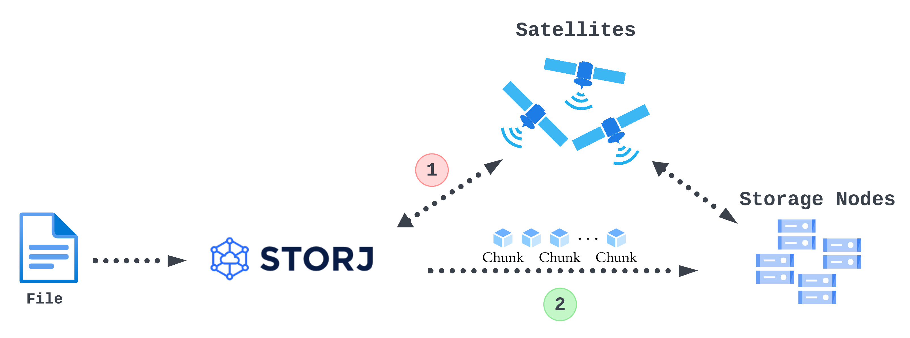
Platform Architectures

Slide 6
Four Key Design Aspects of a Decentralized Storage System
Data Routing
How content is discovered and retrieved
Data Persistence
How content availability is maintained
Incentivization
How participants are motivated to contribute
Resource Requirements
Hardware and computational demands for participation
Notes:
These design choice can fall 4 categroies

Slide 7
Diverse Design Choices Across Platforms
Platform | Data Persistency | Data Routing | Incentivization | Resource Requirements
IPFS | Not Guaranteed | Kademlia DHT | N/A (Free) | Medium
Filecoin | Guaranteed by Storage Provider | Kademlia DHT | Cryptocurrency (FIL) | High
Swarm | Duplication, Erasure Coding | Kademlia DHT | Cryptocurrency (BZZ) | Medium
Storj | Erasure Coding | Satellites | Cryptocurrency (Storj) | Low

Slide 8
Design Spectrum of Decentralized Storage Platforms
How do these design choices affect adoptions, performance, and sustainability
Notes:
- ADD ANIMATION FOR EACH

Slide 9
Network Analysis
Monitored IPFS, Filecoin, Swarm, and Storj using platform-specific crawlers
Collected network snapshots every 12 hours over 50 days (March – May 2024, and February – April 2025)
Each snapshot we record
Total peer counts
Peer’s neighbor information (if applicable)
Peer’s IP address

Slide 10
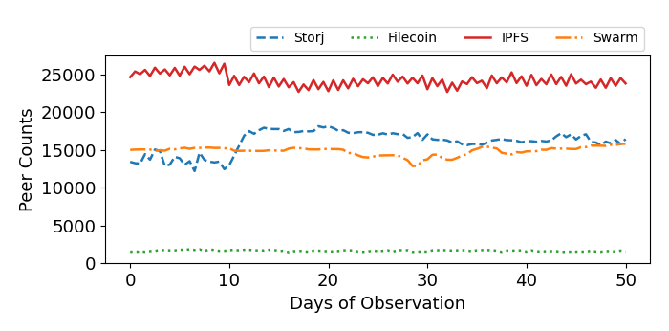
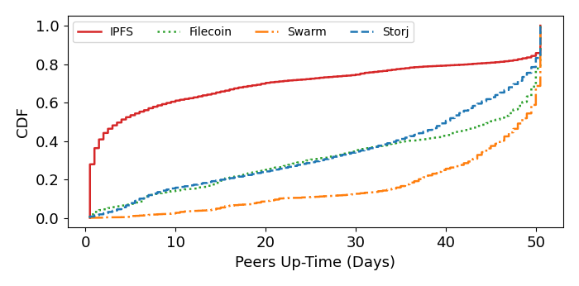
Network Size and Uptime 2024
IPFS maintains the largest network size, but most peers are short-lived
Platforms with incentivization have more stable peer uptime
Filecoin has the smallest network size due to high resource requirements
Notes:
Highlight the figures

Slide 11
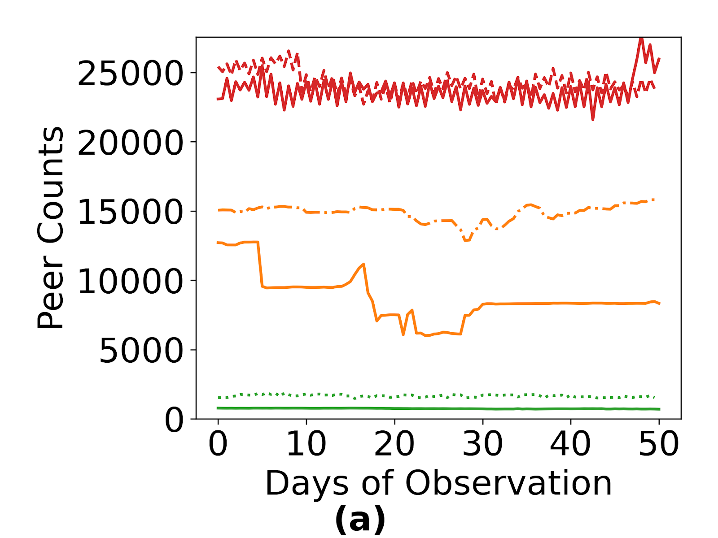
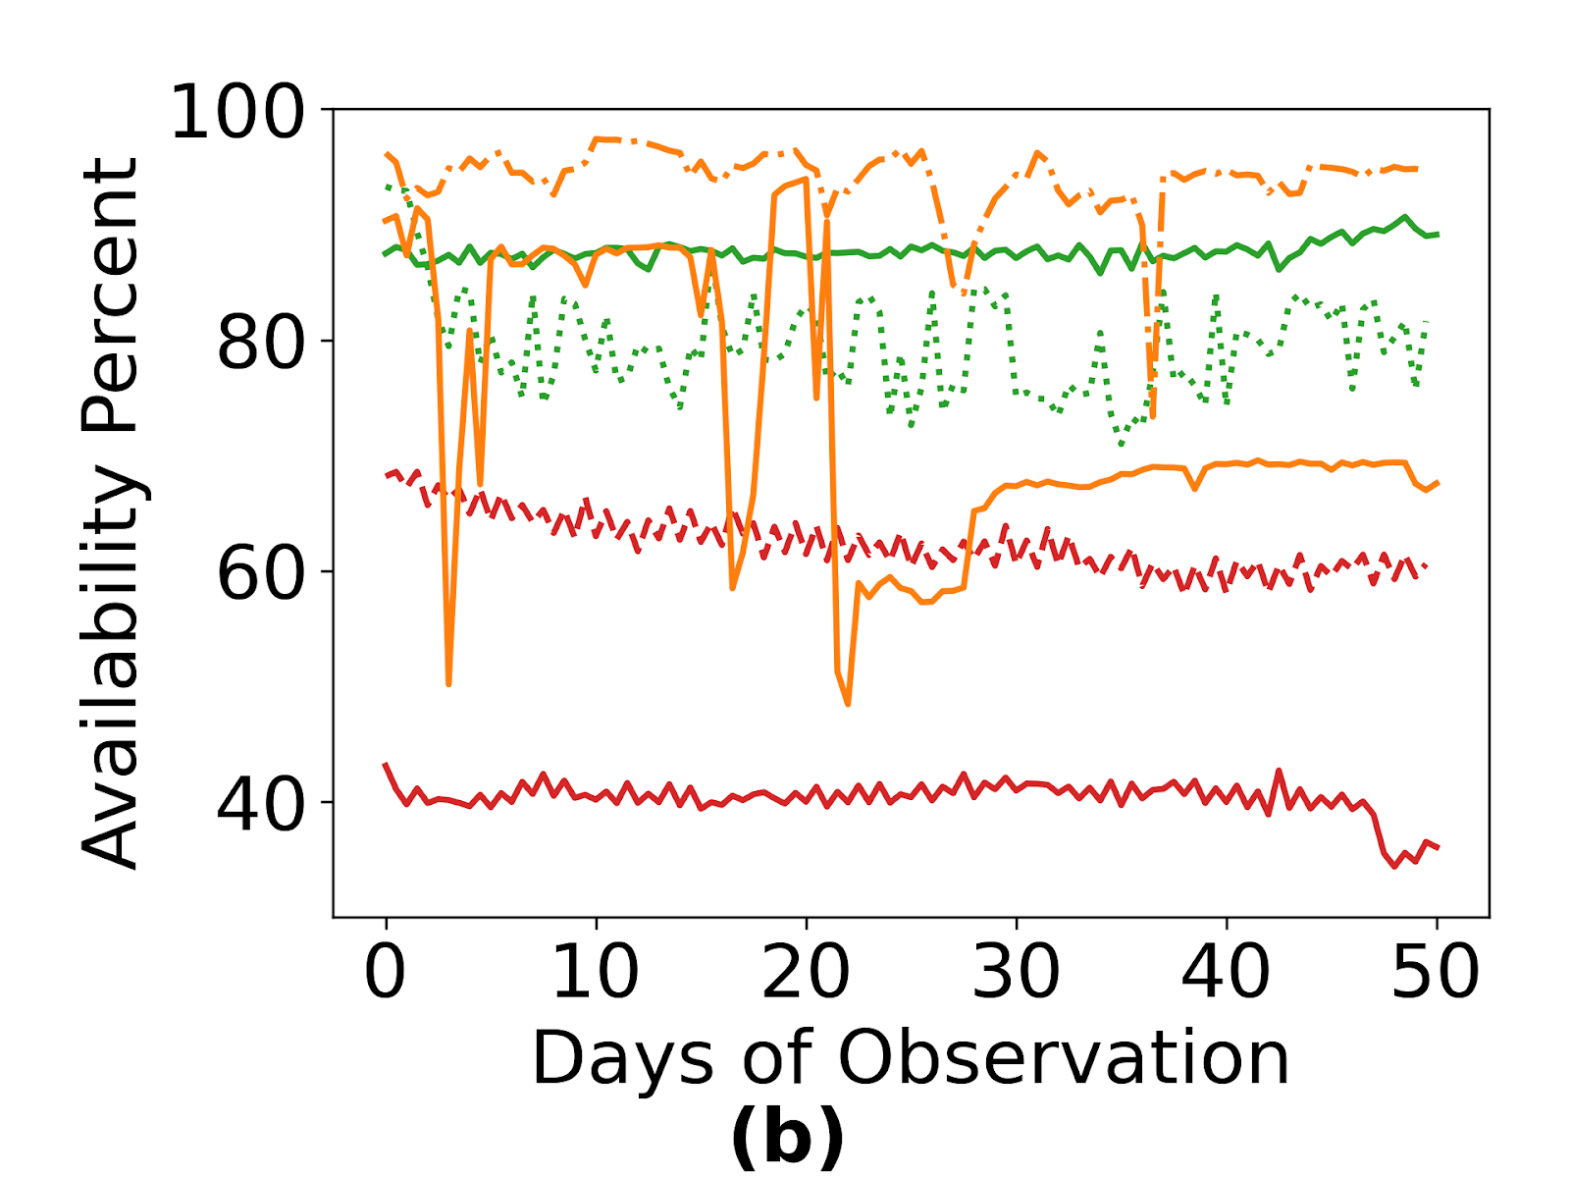
Network Size and Uptime 2025
IPFS remains the largest and stable peer count, but peer availability has reduced
Swarm and Filecoin both suffer peer loss, but remain high on peers' availability

Slide 12
Takeaway from Network Analysis
High adoption doesn’t guarantee network stability
Hardware/resource demands strongly limit network size
Incentive mechanisms improve peer availability and uptime

Slide 13
Upload and Download Performance Measurement
Upload experiment: 3 sizes [5MB, 50MB, 512MB] from two locations [US, Germany]
Download experiment: previously uploaded files across five locations[US, Germany, Japan, Australia, Chile]
Measured download time and time-to-first-byte (TTFB)
Included Google Drive as a centralized baseline for comparison
Notes:
Remove the upload time
Simplied

Slide 14
Upload Time Across Systems
Filecoin shows extremely long upload durations due to blockchain-based commitment
File Size | IPFS | Filecoin | Swarm | Storj | Google Drive
5 MB | 3.35 s | N/A | 117.6 s | 1.18 s | 0.94 s
50 MB | 7.72 s | N/A | 99.98 s | 2.20 s | 1.51 s
512 MB | 19.54 s | 24.6 hrs | 1002.06 s | 17.88 s | 7.42 s
US Upload Time
Storj achieves fast performance, close to Google Drive
Filecoin shows long uploads in terms of hours
Swarm is significantly slower than IPFS
The upload performance from Germany follows a similar trend
Notes:
Highlit the number

Slide 15
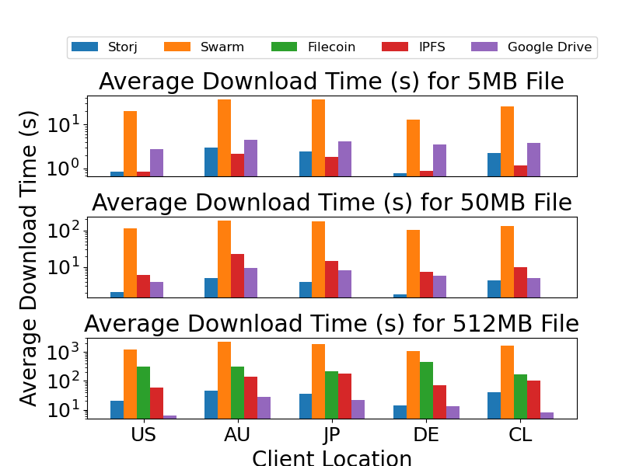
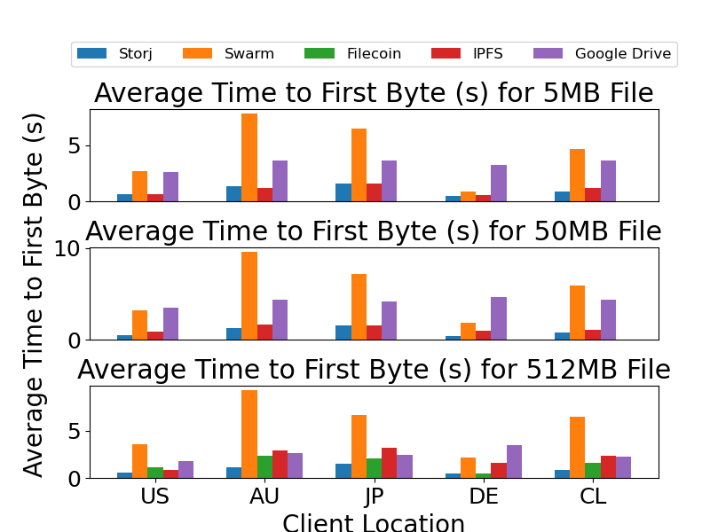
Download Time Vs TTFB
Storj consistently has the shortest download time
For small files, IPFS and Stroj outperform Google Drive in download time and TTFB
Decentralized systems’ TTFB is more consistent than Google Drive

Slide 16
Takeaway from Performance Experiments
The design choice of data routing and data persistence directly affects upload and download performance
Storj offers performance closest to centralized systems
TTFB is stable across decentralized platforms, often more consistent than Google Drive

Slide 17
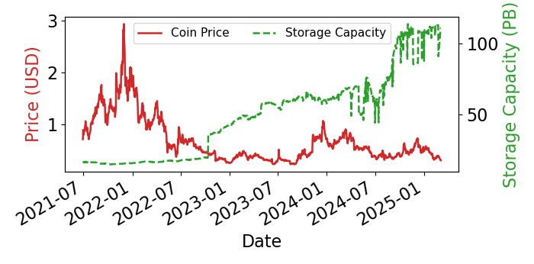
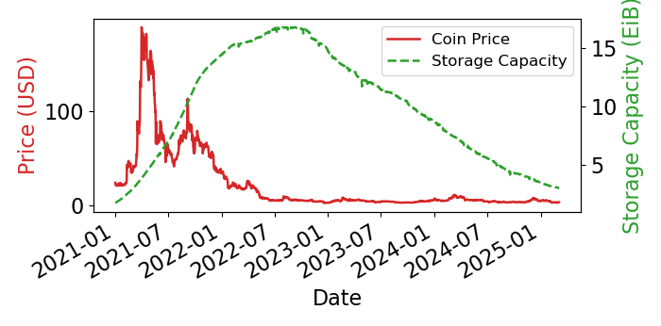
Cryptocurrency Price vs. Storage Commitment
Storj
Filecoin
Adoption does NOT always follow the token price.
Design choice also matters.
Storj’s storage capacity grew steadily despite volatile token prices
Filecoin’s storage capacity declined alongside its prolonged token devaluation
Notes:
Why no IPFS and swarm

Slide 18
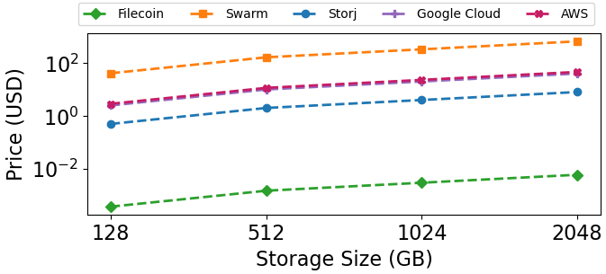
Storage Pricing
Storj with its performance closest to centralized storage system only cost $4/TB/Month
Filecoin's ultra-low pricing ($1/TB/Month) shows a supply-heavy market
Swarm’s high cost ($335/TB/Month) indicates limited scalability or inefficient incentivization

Slide 19
Summary
No one-size-fits-all: Different platforms make distinct trade-offs between decentralization, performance, and usability
Performance is tightly linked to design choice: Data routing and persistence directly impact the user experience
Economic incentives influence network stability: Token rewards improve peer reliability
Sustainability depends on more than crypto incentivization: Long-term viability requires the right balance of reward, operational cost, and high-performance system architecture design

Slide 20
Questions?

Slide 21
Backup Slides

Slide 22
Recommended Resource Requirements
Platform | CPU | RAM | Storage | GPU
IPFS | 2 cores | 6 GB | N/A | N/A
Swarm (Light Mode) | Any | Any | N/A | N/A
Swarm (Full Mode) | 2 cores | 8 GB | 30 GB SSD | N/A
Storj | 1 core | 2 GB | 2 TiB | N/A
Filecoin | 8 cores | 256 GB | 2 TiB NVMe SSD | Nvidia GPU with at least 11 GB VRAM

Slide 23
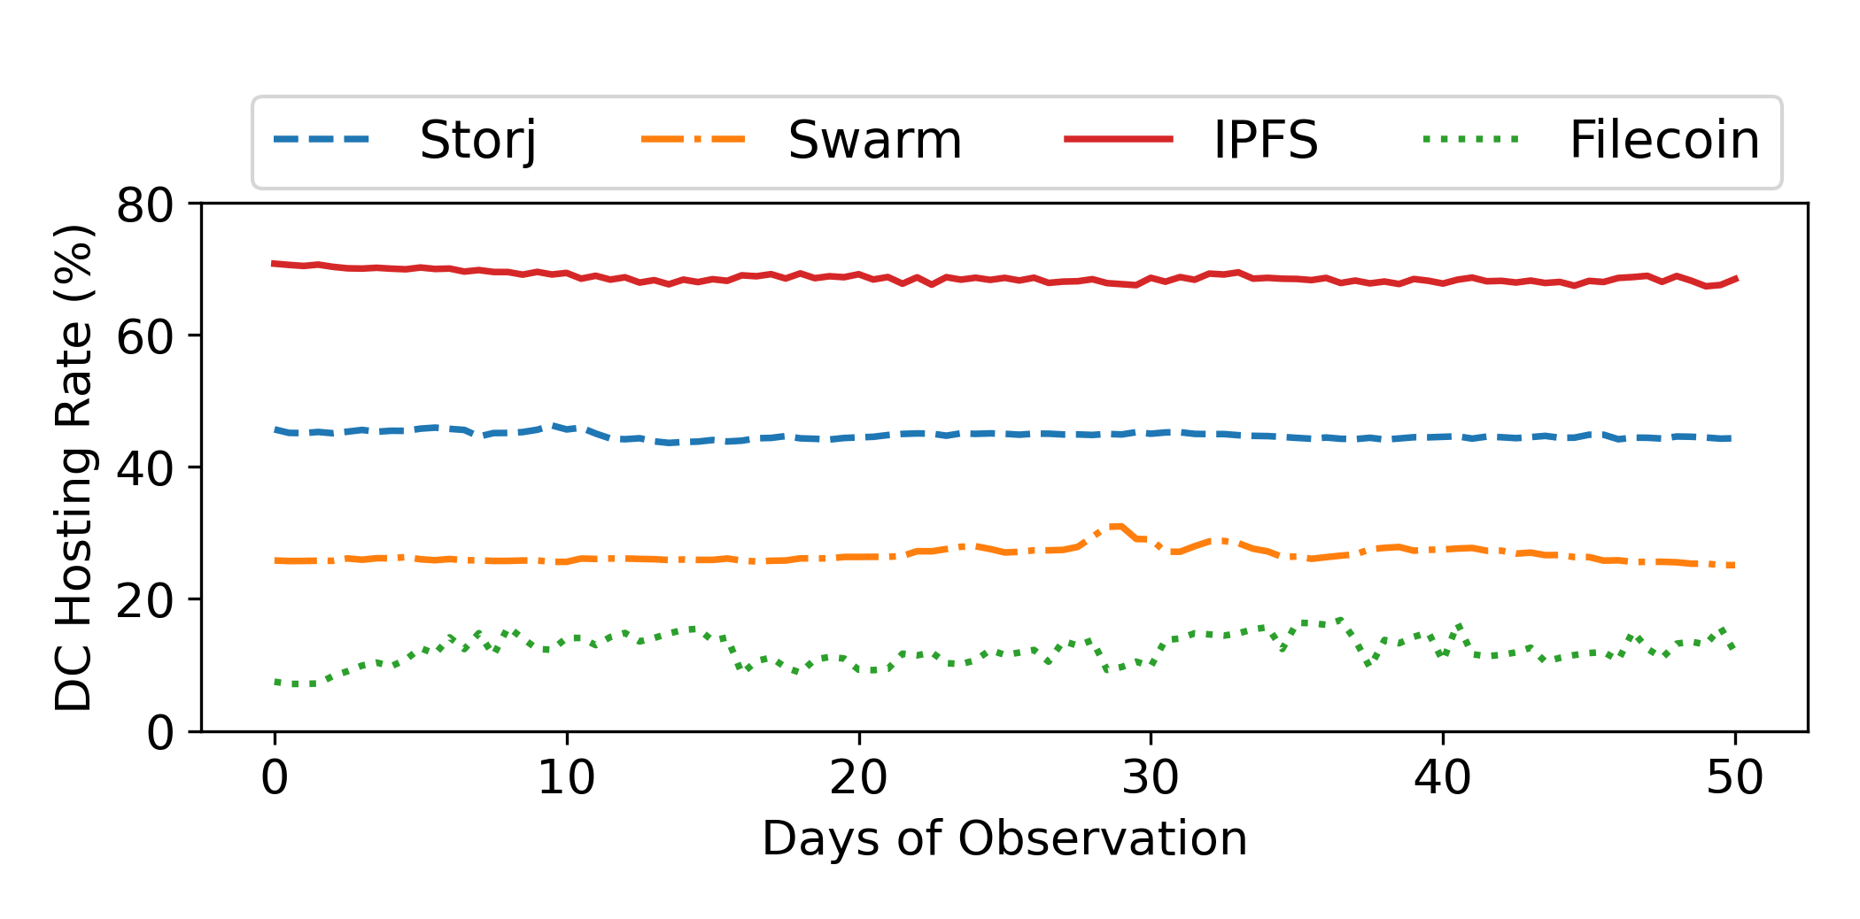
Hosting Infrastructure
IPFS has significantly high datacenter hosting
Filecoin has the lowest datacenter rate due to hardware demands
Heavy reliance on data centers may reintroduce centralization risks

Slide 24
Download Throughputs
Platform | US | AU | JP | DE | CL
StorJ | 147.55 | 60.47 | 60.47 | 185.57 | 70.81
Swarm | 3.03 | 1.70 | 1.84 | 3.59 | 2.35
Filecoin | 13.49 | 13.51 | 19.05 | 8.81 | 25.11
IPFS | 60.74 | 21.76 | 24.02 | 52.86 | 38.18
GoogleDrive | 247.15 | 67.22 | 82.94 | 130.99 | 197.96
Average Download Throughput (Mbps)
StorJ outperforms other decentralized platforms across all regions
Swarm shows the lowest download throughput cross locations

Slide 25
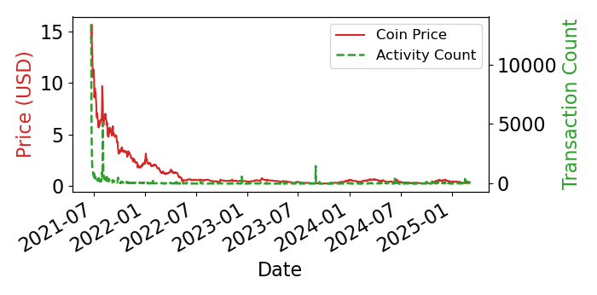
Swarm Crypto Price vs. Transaction Counts

Slide 26
Beyond IPFS: The Decentralized Storage Ecosystem
All aim to provide censorship-resistant, persistent, and user-controlled storage for Web3
But: No systematic cross-platform evaluation exists
Our goal: Compare adoptions, performance, and sustainability across the decentralized storage space
Notes:
- Show the platform we are going to do study - Removed other logo

Slide 27
Price vs Capacity
Collected historical crypto coin prices (FIL, STORJ, BZZ) from CoinGecko
Measured storage capacity trends using official dashboards and on-chain data

Slide 28
How Web3 Solves These Problems
Web3 addresses Web2’s core limitations through a layered architecture:
Protocol Layer : Coordinates trust and consensus through blockchains
Data Layer: Provides verifiable, persistent, and censorship-resistant storage
Service Layer: Enables cross-platform interoperability
Application Layer: Powers end-user applications
Access Layer : Facilitates user authentication, identity, and naming without centralized providers

Slide 29
Web3 Adoption & Market Statistics
Web3 Market Size & Growth
The global Web3 market is projected to grow from $3.2B in 2023 to $33.5B by 2030 [1]
Developer Engagement
Over 27,000 active monthly Web3 developers in 2024 [2]
Enterprise Adoption
Major tech companies like Meta launched web3 related services between 2022–2024 [3]
Funding & VC Activity
Web3 startups raised over $7.5B in venture capital in 2023 alone [4]
[1] Grand View Research (2024) https://www.grandviewresearch.com/industry-analysis/web-3-0-market-report [2] Electric Capital Developer Report (2024) https://www.developerreport.com/
[3] Mata NFT https://about.fb.com/news/2022/05/introducing-digital-collectibles-to-showcase-nfts-instagram/
[4] Crunchbase https://www.crunchbase.com/hub/web3-startups

Slide 30
What Web3 Trying to Solve?
Web3 aims to address fundamental issues created by the Web2 paradigm:
Centralization: Single point of failure
In 2022, a misconfigured update at Cloudflare took down hundreds of sites globally, including Discord and Coinbase [1].
Censorship: Platform-controlled content
YouTube has demonetized thousands of creators without clear explanation, often due to vague or inconsistently enforced policies [2].
Privacy Violations: Unconsented data exploitation and leak
In the Cambridge Analytica case, data from millions of Facebook users was harvested without clear consent and used for targeted profiling [3].
[1] Cloudflare Blog, https://blog.cloudflare.com/cloudflare-outage-on-june-21-2022/ [2] The Verge, https://www.theverge.com/2023/1/13/23553746/youtube-swearing-advertising-policy-change
[3] The Guardian, https://www.theguardian.com/news/series/cambridge-analytica-files
Notes:
Combine the 3 and 4 together, by saying the vision, writing the issue as bullet point

Slide 31
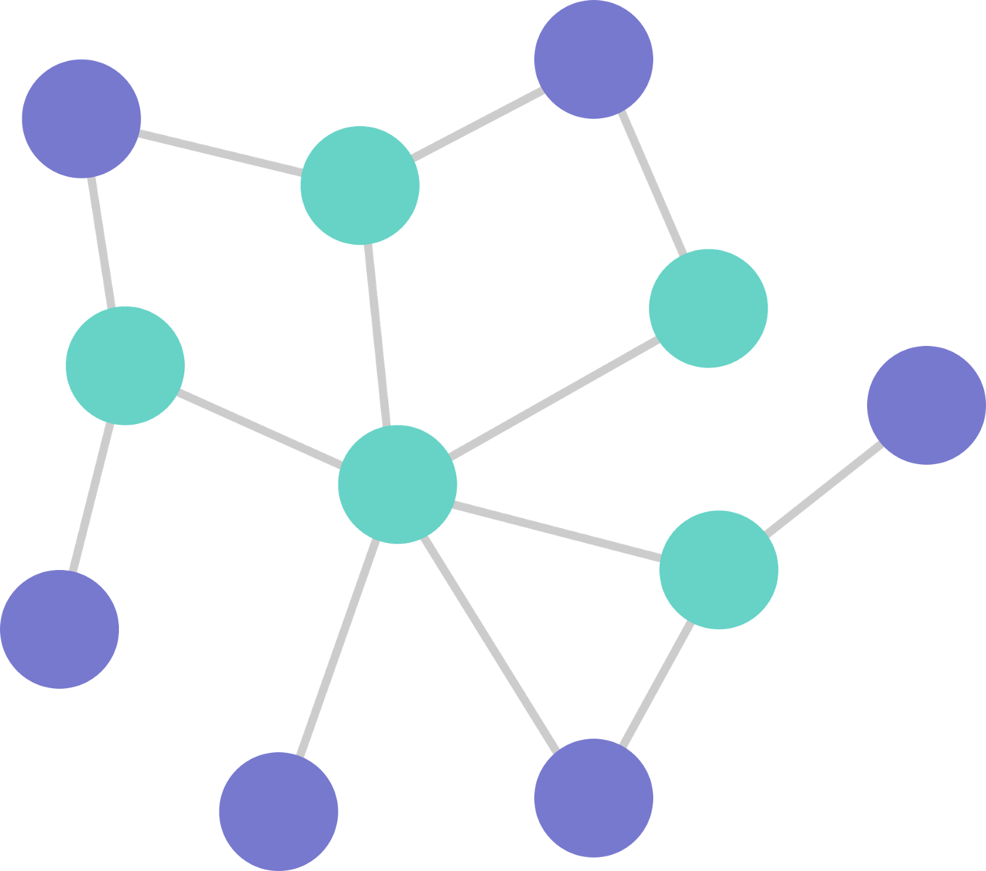
IPFS workflow
File Data
Provider
Requestor
CID
CID
File
CID
Provider Record
Provider Record
IPFS DHT
Chunks

Slide 32
What Makes Web3 Unique?
Feature | Web1 (1990-2000s) | Web2 (2000-2020s) | Web3 (2014s-)
Interaction Model | Read-only | Read-write | Read-write-own
Data Ownership | Limited/Publishers | Centralized (Platforms) | Decentralized (Users)
Infrastructure | Centralized servers | Cloud platforms & CDNs | Peer-to-peer Network
Trust Model | Single Provider | Trusted Intermediaries | Cryptographic Proofs
Content Monetization | Static Ads | Data-driven Ads | Cryptocurrency & Tokens

Slide 33
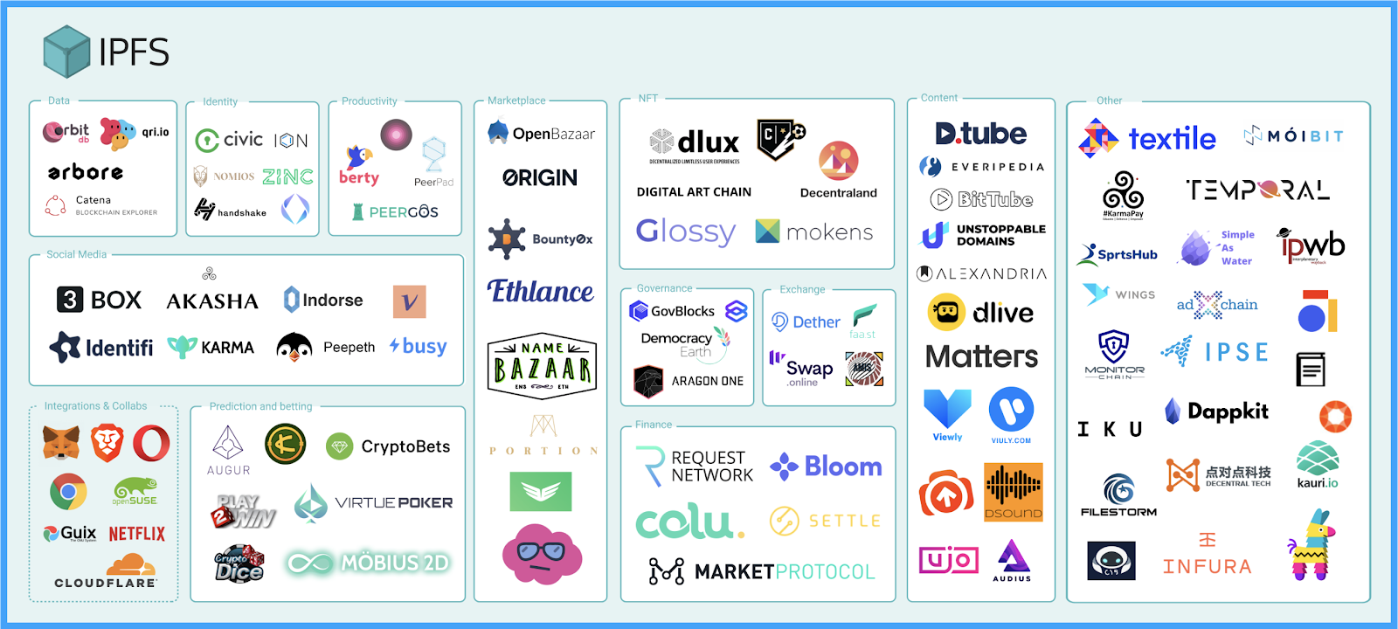
IPFS Ecosystem

Slide 34
Characteristic of IPFS network
“Mapping the interplanetary filesystem.” – Henningsen, Sebastian, et al. in IFIP Networking Conference (Networking) 2022
Findings
IPFS has an average of over 44k peers online at a given time and is geographically distributed
The churn rate of the IPFS network is relatively short with over 70% of nodes join and leave the network within 10 minutes
Studies done by Xia et al. also conduct similar study on understanding the IPFS network and found similar result
Notes:
Say passive measurement on the IPFS network
and Smith et al. explores the uniqueness of IPFS network structure

Slide 35
Dtube: Existing video streaming service with IPFS
Dtube built its platform on top of the blockchain (Avalon) and uses IPFS as its video storage system
Dtube has seen 1 upload/minute and 4 million monthly unique visitor
But
Dtube uses its own private IPFS clusters
Notes:
we are not the only people thought about this idea.
Dtube is a streaming services that uses IPFS as its video storage system It has seen 1 upload per minute and 4 million month unique visitor
Videos cannot be loaded from public IPFS network
Explain why is bad to be private
In fact we don’t if truly decentralized video streaming is possible on IPFS

Slide 36
Related Work on Dtube
"Measuring decentralized video streaming: A case study of dtube." – Doan, Trinh Viet, et al. IFIP Networking Conference (Networking) 2020
Findings:
Dtube lack of geographically distributed servers and caches
Dtube cannot duplicate or distribute to the public IPFS network which is globally distributed
Notes:
Measures the streaming performances of Dtube by loading videos across 4 different cellular ISPs in 3 different countries over 10 months period.

Slide 37
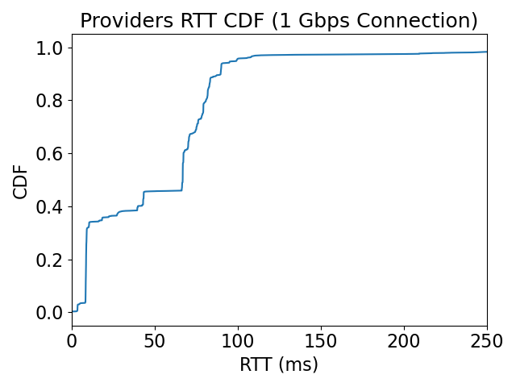
High RTTs from videos’ provider
90th Percentile: 90 ms
Median 67 ms
Notes:
One of the reason is that RTTS for videos provider wilth a median of 67 ms , 90th

Slide 38
Measurement Setup
IPFS Network
Network Condition
- 1 Gbps
- 25 Mbps
- 8 Mbps
Collected data from September 1st to October 4th of 2022.
Retrieved 39,259 unique video CIDs from IPFS SEARCH
Downloaded 28,652 videos from the IPFS network
Get Videos’ CID
IPFS Instance
…
Sniffs the network
IPFS Instance
CIDs
IPFS Instance
…
IPFS Instance
Client Machine
Measures
- Video Resolution
- Video Stalls
- RTT to Provider
IPFS Instance
CID
Notes:
To collect video from IPFS we used IPFS SEARCH
Recall IPFS is content base addressing, which means that content identifier is the hash of the content
There is no name or humanreadable label we can directly search.
IPFS-search solves the problem by deploying multiple IPFS instances into the network and sniffs other IPFS instance to see what files they have.
Then they download and index the file.
We queried all videos CIDs from IPFS search
For each CID we try to retrieve them from the IPFS network
Upon retrieval, we will measure x x x
We also retrieve the video under different network condition
Collect data xxx
Xxx
Xxx
Summary:In fact, we see people are sharing videos on IPFS, our goal is to understand how video stream works and performs, lets see some results to show how poor videos streams on IPFS

Slide 39
Evaluation Setup
IPFS Network
IPFS Instance Middle East
IPFS Instance Europe
IPFS Instance Asia East
IPFS Instance US West
IPFS Instance US West
Client
IPFS Gateway
Cache hit rate of 60% and 80%
Located: Northeast US
Notes:
For evaluation setup, we deployed videos into IPFS network across the globe and set a cache hit rate of 80 and 60% (cache hit rate meaning)
. And the client and telescope is collocated at northest US

Slide 40
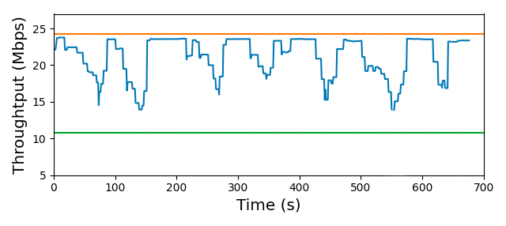
Why the Manifest file
Throughput for Client <-> Gateway
Throughput of segments are cached
Throughput (Mbps)
Telescope’s Update
Telescope’s Update
ABR Client
Time (s)
Throughput for
Client <-> IPFS Network
Throughput for
segments not cached
Notes:
Why updating the manifest file?
Here is a trace of client's estimated throughput, during a playback.
As we mention earlier that abr client cannot distinguish the video segments coming from cache ipfs instance which caused inaccurate estimation.
What telescope does it to update the manifest file to match this inaccuracy.
For example, we have a segment is cached, and telescope will update the manifest so that client will think it has the orange throughput.
Same for the uncached segment, telescope will add penailty so that client will think it has the green throughput.
By incorporating the segments location information into the manifest file
the abr client can make the better decision even the estimation is inaccaurate

Slide 41
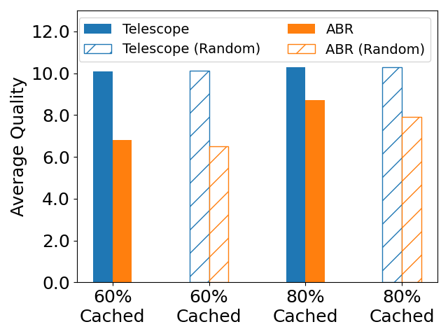
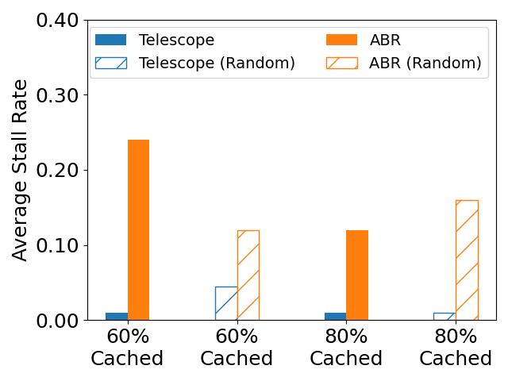
Telescope’s video quality and stall performance
18%
48%
91%
91%
Notes:
Animation on figures
However QoE does not tell the full story, as it considered quality, video stall, and video quality variation all together.
Figure on the left show the average video quality compare against ABR, for 60 cache hit rate, Telescope outperforms ABR by 48% and for 80% it outperforms by 18%
The figure on the right shows the Telescope’s video stalls compare to ABR. Under 60% and 80% cache hit Telescope reduced the stall rate by 91%.
Mention smoothness
Which means that Telescope is able to select high quality video while maintaining low stall.
A banner about other experiment we did

Slide 42
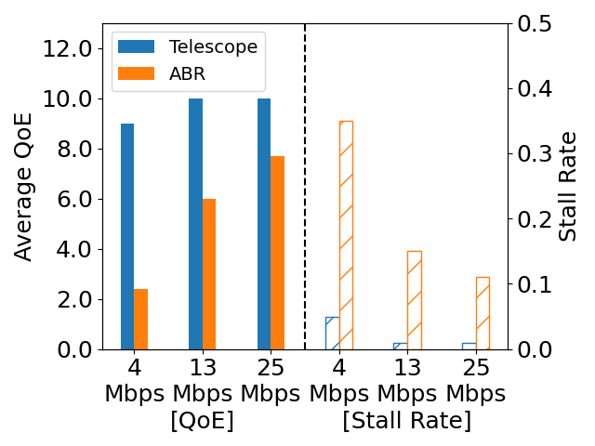
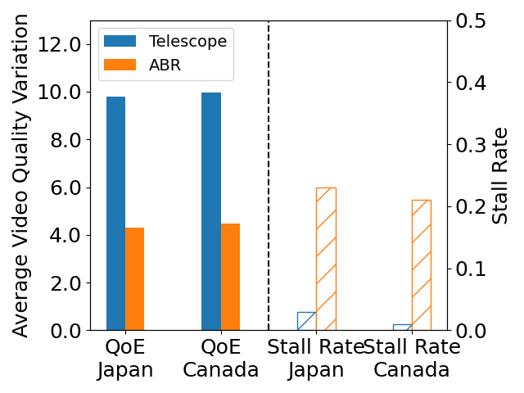
Telescope’s performance under various network and geo-location
60% Cache
60% Cache
46%
29%
275%
85%
127%
123%
86%
95%
93%
95%
Notes:
We also evaluated telescope under different network conditions and geolocation. The figure on the left shows the Telescope able to maintain high QoE under
The figure on the right shows the QoE and Stall when the client is under different geolocation.
We see little difference between different client which indicates that Telescope does not effect by the client location.

Slide 43
Related Work on Sensitive File Sharing
"How Bad Can It Git? Characterizing Secret Leakage in Public GitHub Repositories." – Meli, Michael,et al. NDSS’19.
Findings:
Secret leakages of private keys and API keys are pervasive, affecting over 100k repositories
Thousands of new unique secrets are leaked every day
Our goal is to investigate this behavior on IPFS
Notes:
Large scale measurements on secret files being published to public repository on GitHub
This study give the insight on secrets are being leak on heavily tech and developer oriented platform, GitHub.

Slide 44
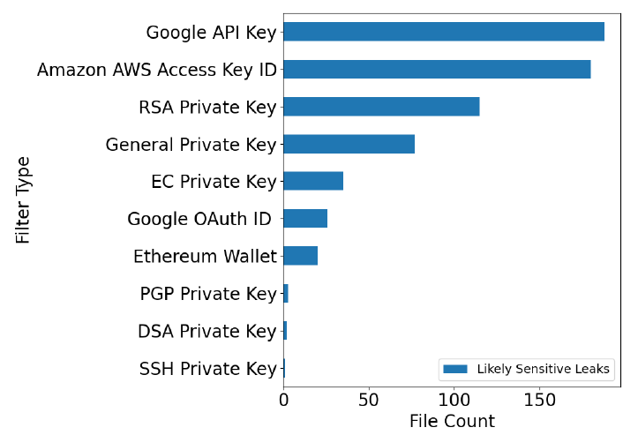
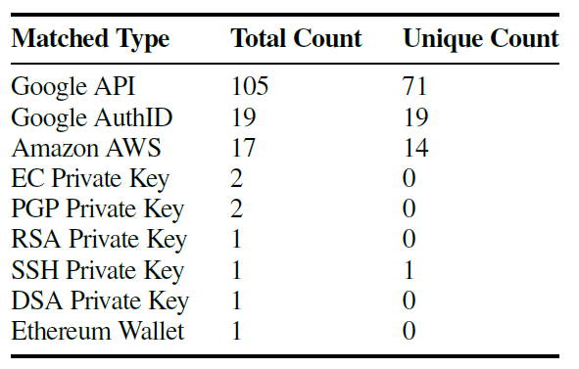
Sensitive Files with Our Own Search
For non-compressed files we identified 105 unique files that contain sensitive information
For compressed files we identified 647 unique sensitive files that contain sensitive information
Sensitive files leaks over uncompressed files
Sensitive files leaks over compressed files
Notes:
Banner saying they

Slide 45
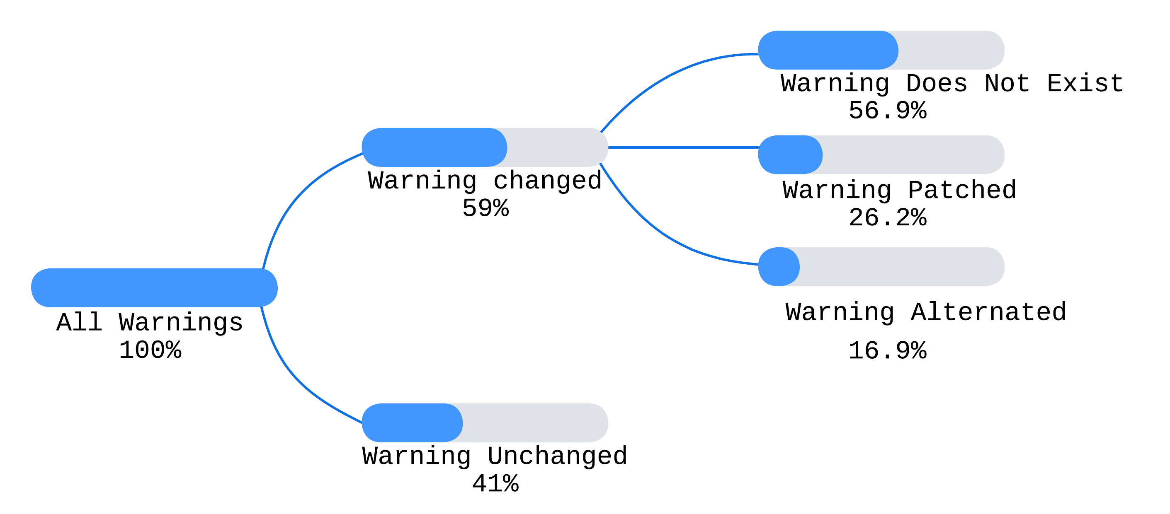
Case study on GitHub
We identified 1,043 unique GitHub repositories from the compressed files
We compared the repository of the latest version on GitHub with the IPFS version we collected

Slide 46
Honeypot Experiment
Decoy Files
IPFS Network
Beacon Files
IPFS Instance Brazil
IPFS Instance UK
PDF
HTML
MS Word
IPFS Instance Japan
IPFS Instance US
IPFS Instance Australia
SSH Key
Control
Crypto Wallet
Notes:
Have figures to show the experiment

Slide 47
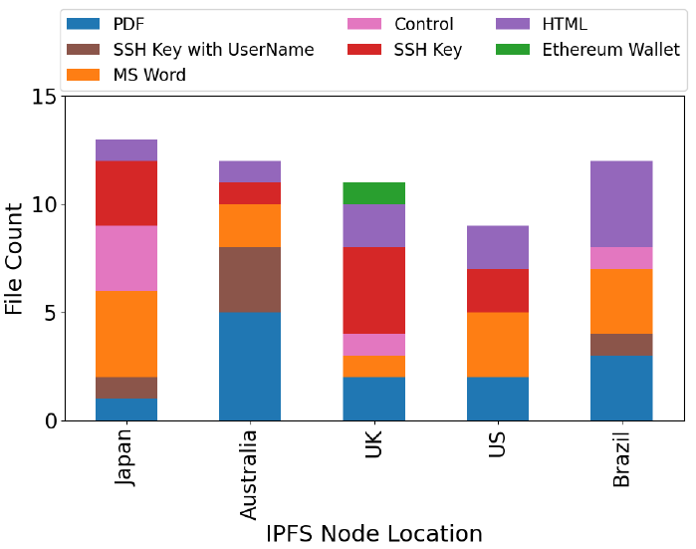
Honeypot Result
We observed different files are being download from our honeypot node
We did not notice any attack being performed
Downloaded File Type From Different Location

Slide 48
Our Contributions so far
Performance
Usability
Security
WWW '23
TMA '25
IFIP Networking '24

Slide 49
Related Work
Related studies on IPFS has conclude various perspective of IPFS
Performance and Characteristic of IPFS network
Security in IPFS network
Content and Privacy in IPFS
Notes:
due to the recent development of IPFS there is limited related work
I am only present the high level related work with IPFS.
And I will present related work for specific project

Slide 50
Performance and Characteristics of IPFS
"Design and evaluation of IPFS: a storage layer for the decentralized web." – Trautwein, Dennis, et al. in SIGCOMM ‘2022
Findings
IPFS peers are not running on the cloud with less than 2.7 % out of 2,715 ASN identified as cloud infrastructure
IPFS’s publication time is relatively long, with a median of 33.8 seconds
IPFS file (small) retrieval time is relatively short, with 99% of the retrieval taking less than 1.26s
Notes:
The study Evaluated IPFS’s performance from the perspective of content publication and retrieval
Study done by De la Rocha et al. has focused on improving IPFS’s content routing performance and Shen, Jiajie, et al. have focused on IPFS’s IO performance

Slide 51
Security in IPFS
“Total Eclipse of the Heart – Disrupting the InterPlanetary File System” – Prünsterm, Bernd et al., USENIX Security 2022
Findings
IPFS’s DHT routing is vulnerable to eclipse attacks.
No authentication or reputation mechanisms in peer discovery
The authors performed a real-world attack by deploying ~500 Sybil with a cost of ~€2000. The attacker successfully intercepted over 98% of the victim’s routing queries.
Notes:
Study done by Zheng et al., NDSS 2024 shows that IPFS is vulnerable to censorship attacks by polluting DHT records. A simple Sybil-based strategy can suppress content visibility for up to 48 hours at a cost of under $5.

Slide 52
Content and Privacy of IPFS
"Monitoring data requests in decentralized data storage systems: A case study of IPFS." – Balduf, Leonhard, et al. ICDCS ‘22
Findings
Popular IPFS contents belong to a decentralized exchange, JSON files for Ethereum nodes, and HTML pages stating “Unavailable for legal reasons”
IPFS’s user’s privacy is at risk and the study demonstrates that individual peer’s activity can be traced through the monitoring of the network
Notes:
Passively measured the traffic on IPFS and conduct active experiments to identify traffic patterns by IPFS peers
Studies done by Xia et al. also examined content being published to the IPFS network and found similar result

Slide 53
Is IPFS ready for decentralized video streaming?
Video is the most popular traffic on the Internet^{[1]}
IPFS has strong robustness against failures and censorship with decentralization
With the popularity of IPFS, we ask:
Can video streaming utilize the benefits of the IPFS network to achieve a better playback experience
[1] Sandvine. (n.d.). Sandvine’s 2023 global internet phenomena report shows 24% jump in video traffic, with netflix volume overtaking youtube. shorturl.at/gkzJZ
Notes:
So why video streaming with IPFS? Since video is xxx and
And as we demonstrated easier IPFS xxx, with xxx we as

Slide 54
Measurement study
Collected data from September 1st to October 4th of 2022.
Retrieved 39,259 unique video CIDs from IPFS SEARCH
Downloaded 28,652 videos from the IPFS network
Notes:
We perform a measurement study on videos on IPFS,
We collect x, and download y.

Slide 55
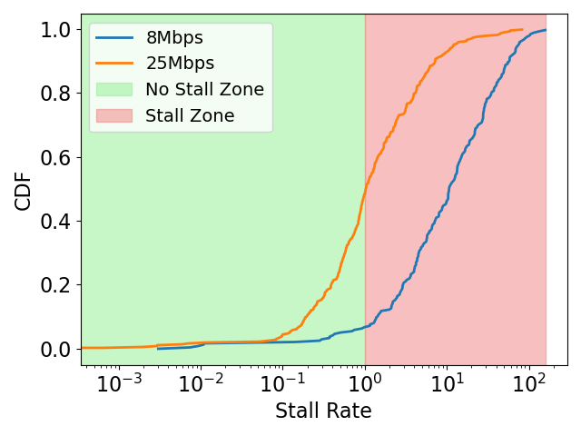
Extreme high video stalls
Median Stall Rate of 5
Median Stall Rate of 9
Notes:
First thing we notice, videos experiences extrem high stall under poorer network conditions.
For 8 Mbps, 90 % of the videos experienced stall and for 25 Mbps 50% experienced stalls
For video that are stalled, the median stall rate for 8 Mbps is 9. This means that the video took 10 times of the video duration to stream (pause, such as 10 times )
For 25 Mbps the median stall rate is 5

Slide 56
Why is the video stall so high?
High RTT of the video provider
Caching partially solves the problem with high RTTs if the videos are cached close to the user.
Single-quality encoding of the video
Video streaming cannot adapt the quality according to the network conditions
How can we improve video streaming on IPFS?
Notes:
So why video stalls are so high?
High RTT can potentially solved by caching content closer to the user
Video cannot adapt the quality according to the network conditions
So how can we improve video streaming on IPFS ?
The natural approach to video streaming under dynamic network condition is adaptive bitrate but I am going to explain how ABR does not work and why it does not work with IPFS.

Slide 57
Existing video streaming solution: Adaptive Bitrate (ABR)
Quality 9 -> 30 Mbps
Quality 5 -> 15 Mbps
Quality 1 -> 5 Mbps
#1
High
…
Low
Manifest File
…
High
…
Low
Video
…
High
…
Low
ABR Client
Server
#N
High
…
Low
ABR Video Segments
Throughput Estimation
Notes:
The natural approach to video streaming under dynamic network condition is adaptive bitrate
Abr works by making the video into segments, and each segment has different quality from high to low
Then these segments are store into a server.
The sever send a manifest file to the ABR client.
A manifest file is the list of bandwidth requirement for different quality segments
Then the ABR client estimate the network throughput from the client to server and pick the best affordable quality

Slide 58
ABR with IPFS
IPFS Network
#1
High
…
Low
…
Manifest File
…
High
…
Low
IPFS Instance
IPFS Instance
Video
…
High
…
Low
ABR Client
ABR client cannot estimate network throughput correctly because videos can be retrieved from the cache or instances from the IPFS network
#N
High
…
Low
Cache
ABR Video Segments
Throughput Estimation
Notes:
Now lest see how ABR is deployed with IPFS.
Everything is similar to traditional ABR But instead storing video segments to a server, now they are stored into IPFS network.
video segments can be stored into IPFS instances or cache instance.
Then ABR client will try to estimate the throughput from client to IPFS network
But Abr client cannot ....

Slide 59
Telescope’s algorithm
Compute and compensate
the inaccurate estimation
Original Manifest File
Updated Manifest File
Cache Info
Throughput Info
Notes:
Telescope take the original manifest files and uses cache and throughput information.
to Compute and compensate the inaccurate estimation by updating manifest file

Slide 60
Telescope
IPFS Network
(Seg-01.m4a)
Qmag … zR5n
IPFS Instance
…
IPFS Instance
ABR Client
IPFS Gateway
Cache
IPFS Instance
Seg-01.m4a
Updated Manifest File
Notes:
To solve this inaccurate estimation problem, we introduce Telescope.
Telescope act like a proxy between ABR client and IPFS gateway.
It can be co-locatted with the client or the Gateway.
When client request the video, Telescope forward to the gateway and the gateway retrieve the segment from the IPFS network or cache.
Then Telescope forward back the video to ABR client, but it also returned an updated manifest file to the client.
Recall that manifest is a list that tells ABR client what bandwidth they need for each quality of the video.

Slide 61
Evaluation Methodology
Baseline
IPFS Vanilla (direct video streaming on IPFS)
ABR (video streaming on IPFS with vanilla ABR)
ABR BOLA and ABR-DYN (ABR with different algorithms)
Metrics
Quality of Experience (QoE)
Video stalls
Video quality
Video quality variation (smoothness of the video)
Under various network conditions
Notes:
our methodology,
For baseline we compared Telescope to direct ipfs streaming and ABR
- Explain why we have different algothrim
Explain the metric and under network donitions
For metrics we used

Slide 62
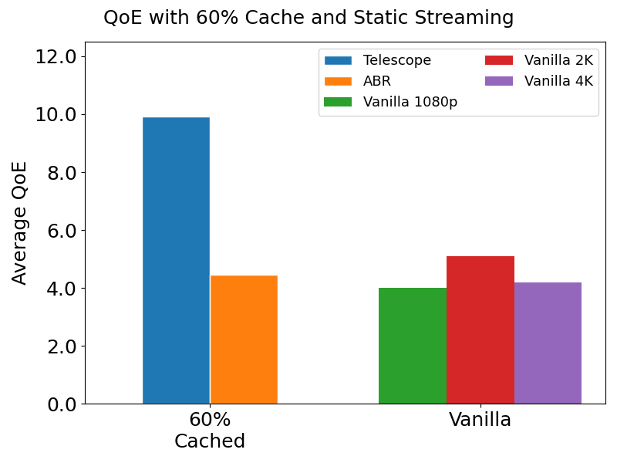
Telescope’s QoE Performance
123%
94%
Telescope also outperforms ABR by streaming video with high quality, low stall rate, and less quality variation
ABR Streaming [60% cached]
Direct IPFS Streaming
Notes:
The figure shows Telescope’s QoE compare agains with tradition ABR and direct IPFS streaming under different resoluition.
Telescope outperforms ABR by 123% and outperforms direct IPFS streaming by 94%
Telescope also outperforms ABR by streaming video with high quality, low stall rate, and less quality variation

Slide 63
Summary
Video streaming on the IPFS performs poorly
Existing video streaming solution ABR performs poorly with IPFS
Telescope improves video streaming with ABR on IPFS significantly by incorporating video source information
Telescope introduces a new way to stream videos that combines the benefits of decentralized video systems and delivers a high-quality viewing experience
Notes:
Due to single encoding and high RTT
Due to videos can be retrieved from multiple sources
Telescope improves
Finally Telescope present a new potential for video streaming solution for distributed video systems with high video stream experience
Mention where the paper is (website)

Slide 64
Sensitive file sharing study
"How Bad Can It Git? Characterizing Secret Leakage in Public GitHub Repositories." – Meli, Michael,et al. NDSS’19.
Findings:
Secret leakages of private keys and API keys are pervasive, affecting over 100k repositories
Thousands of new unique secrets are leaked every day
Our goal is to investigate sensitive leaks on IPFS
Notes:
Large scale measurements on secret files being published to public repository on GitHub
This study give the insight on secrets are being leak on heavily tech and developer oriented platform, GitHub.

