Slide 1
ECON: Modeling the network to improve application performance
Yi Cao, Javad Nejati, Aruna Balasubramanian, and Anshul Gandhi
Department of Computer Science, Stony Brook University

Slide 2
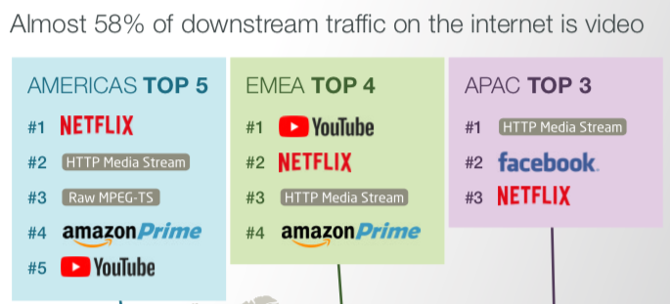
Introduction
Web and video are important applications
  Web and video traffic dominate
  Global Internet Phenomena Report (2018)
  Video traffic: 58%
  Web traffic: 17%
    Goal — Improve Web and video performance
Global Internet Phenomena Report (2018)

Slide 3




App Performance Depends on Cross-Layer Interactions
Applications are built upon the network stack
    Multiple protocols at different layers
  E.g. YouTube video
Youtube
Application Layer
DASH, RTSP
DASH
RTSP
Transportation Layer
BBR, CUBIC
TCP CUBIC
TCP BBR
To improve App performance, it is to crucial to make right protocol choices

Slide 4
Challenges
Protocol 1
…
Protocol n
Making the right protocol choice is not easy
    Each layer has various different protocols
  Numerous combinations
  Difficult to evaluate application performance empirically
Predicting the application performance is difficult
    TCP and Application interact non-intuitively
    Example (Web page load):
  Important to investigate both application and TCP
Algorithm 1
…
Algorithm m
Video
Application Layer
HTML
Image
JavaScript
Image
Underlying TCP
Transportation Layer

Slide 5

ECON – Joint Model of Application and TCP
Why modeling?
    Scalably evaluates the combination of different protocols
  E.g. Evaluating trade-offs of various TCP algorithms
High-Level design of ECON
    We first design an accurate TCP model to predict TCP throughput
    Use the TCP model as a building block to predict application latency

Slide 6
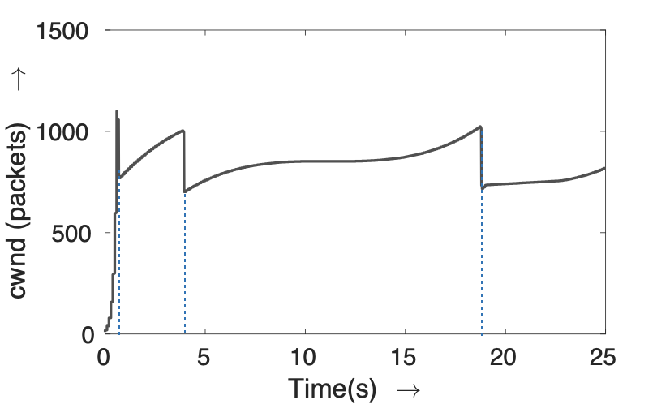
Background on TCP Algorithms
Loss-based TCP algorithms react to packet losses
    Linux default – TCP CUBIC
  Regulates its congestion window (cwnd) using a cubic function
Slow Start
Packet Loss
Tx Reduces 30%
Steady State
To investigate TCP Performance – Performance Models

Slide 7
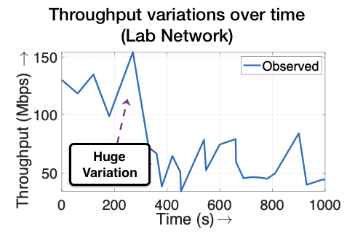
Existing Models Insufficient
Analytical Models
  Represent TCP throughput by theoretical formulas
Mathis/PFTK model for TCP Reno
  Simplified assumptions lead to poor accuracy under dynamic network conditions
Empirical Models
  Predict TCP throughput based on historical data
EWMA (Exponentially Weighted Moving Average)
  Limited responsiveness under dynamic network conditions (e.g. Small RTT)
  Ignore the congestion control dynamics (e.g. Losses affects TCP throughput)
Constant Loss Probability p

Slide 8
Outline
ECON
    Idea
    Empirical Analysis
    Analytical Modeling
Evaluation
    Experimental Setup
    TCP Modeling Evaluation
Application
    Application Layer Model
    Case Study: Speeding up Web Page Loads
    Case Study: Improving Adaptive Streaming
Conclusion

Slide 9
ECON: High-Level Idea
Idea: Analytical Modeling + Empirical Analysis
  Analytical Model to characterize TCP dynamics –– Scalably evaluate different combinations
  Augmented by empirical data –– No need for simplified assumptions
+
Past cwnd values
Packet loss distribution
Analytical Model
Empirical Data
ECON
Hybrid model that combines Analytical Modeling and Empirical Analysis

Slide 10

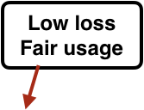
ECON: Empirical Analysis
A close look at the packet loss probability -- p
  Existing models assume loss to be a constant (E.g. PFTK)
  However, in our experiment, we find that p has a close relationship with cwnd
  Reason: cwnd determines the number of packets sent into the network
  Rather than treating p as a constant...
  Model p as an empirical function p(cwnd)
  “Sliding Window” approach -- changing network conditions
constant
Empirical function p describes the spatial distribution of loss
Sliding window updates this function over time

Slide 11
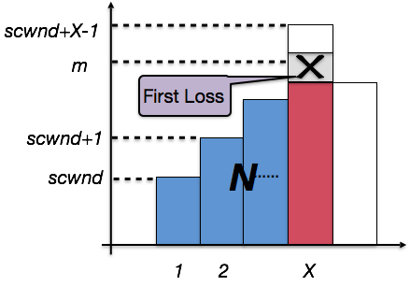
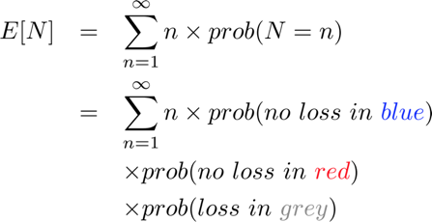
ECON: Analytical Modeling
TCP throughput model (Reno)
  N — the number of packets until a loss appears.
  A — time duration until a loss appears
  To get throughput, need E[A] and E[N]
Essentially the
Empirical p(cwnd)
cwnd
E[A] can be similarly derived
RTT
Congestion window evolution

Slide 12
Outline
ECON
    Idea
    Empirical Analysis
    Analytical Modeling
Evaluation
    Experimental Setup
    TCP Modeling Evaluation
Application
    Application Layer Model
    Case Study: Speeding up Web Page Loads
    Case Study: Improving Adaptive Streaming
Conclusion

Slide 13


Experimental Setup
Network traffic
  The sender generate TCP traffic using iPerf
  Under both TCP CUBIC and Reno
  Use tcpprobe to capture the cwnd
Four real-world networks
  Azure public cloud (VMs)
  Northeast US (Within New York)
  Southeast US (South Carolina -> New York)
  Long-distance (Korea -> New York)
We compare ECON with alternative models
  Analytical: PFTK and its variations
  Empirical: EWMA, Holt-Winters, Last Sample, Harmonic-Mean
Sender
Receiver
660 hours worth of experimental data

Slide 14
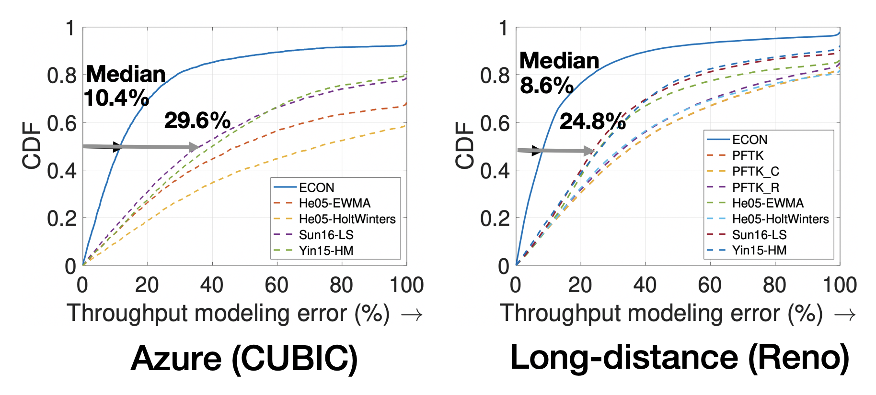


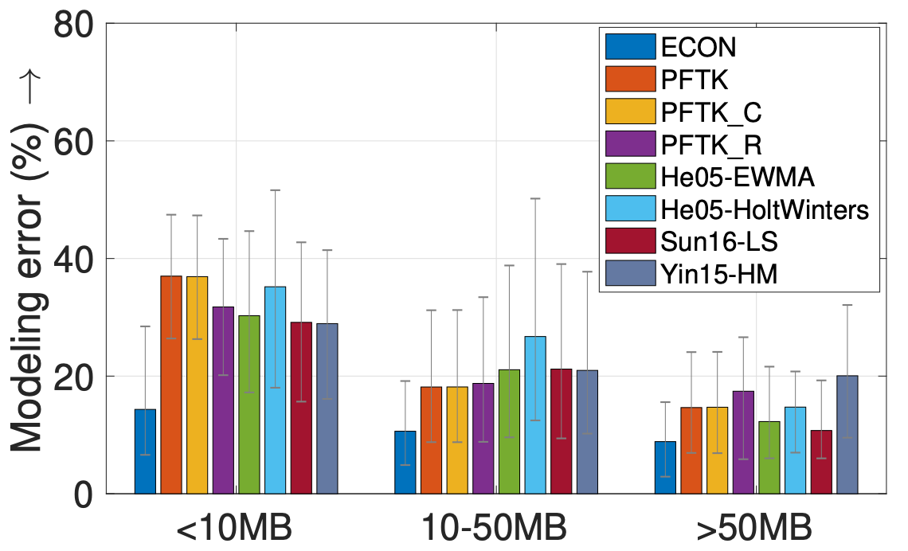

TCP Modeling Evaluation
Throughput prediction error CDF
  Significantly outperforms other models
Evaluation in terms of latency (CUBIC)
  Latency prediction error for different file sizes
  ECON provides greater benefits
  For small data sizes
Median Error for TCP CUBIC
Network | Azure | Southeast | Northeast | Long-Dist
ECON | 11.5% | 15.5% | 9.2% | 11.6%
Best Alternative | 36.1% | 67.8% | 28.5% | 33.5%
78% Error Decrease
Greater
Benefits
ECON performs well for both short and long flows

Slide 15
Outline
ECON
    Idea
    Empirical Analysis
    Analytical Modeling
Evaluation
    Experimental Setup
    TCP Modeling Evaluation
Application
    Application Layer Model
    Case Study: Speeding up Web Page Loads
    Case Study: Improving Adaptive Streaming
Conclusion

Slide 16
ECON: Application Layer Model (1/2)
Extend to Web model
  Goal: Choose whether to use HTTP/1.1 or HTTP/2
  Need to predict the page load time (PLT)
Page load information
PLT: 2.1s
Video
H1/H2
2s
ECON
TCP Model
HTML
20MB
Image
0.8s
0.1s
4MB
200KB
JavaScript
0.2s
Image
Latency
Predictions
500KB
0.5s
3MB

Slide 17
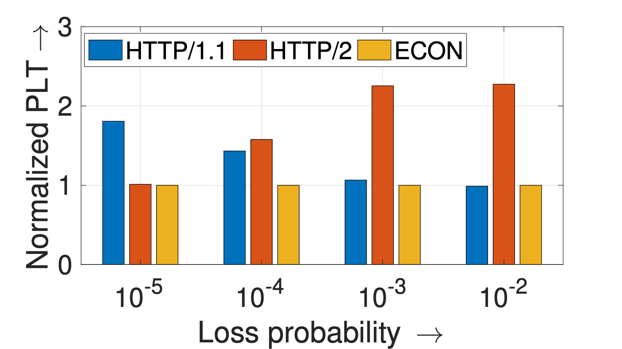
Case Study: Speeding up Web Page Loads
Whether to use HTTP/1.1 or HTTP/2
  Emulate the page load process
  Then use the empirical results to validate
  our model
  Experiments — 10 Web pages
  50ms RTT
  4 Loss rates: 10⁻⁵, 10⁻⁴, 10⁻³, 10⁻²
  Web record and replay
  Whether to choose HTTP/1.1 or HTTP/2 is not trivial
  ECON can enable accurate predictions
ECON predicts the right protocol 80% of the time
Loss Prob. | 10⁻⁵ | 10⁻⁴ | 10⁻³ | 10⁻²
Pred. accuracy | 10/10 | 8/10 | 8/10 | 8/10
PLT improv. | 44.8% | 36.5% | 55.0% | 56.0%
Avg PLT for all pages under different network conditions
HTTP/2 Better
HTTP/1.1 Better

Slide 18

ECON: Application Layer Model (2/2)
Extend to Video Model
  Goal: Choose the highest bitrate without rebuffering
  DASH (Dynamic Adaptive Streaming over HTTP)
  Core: Adaptive bitrate selection algorithm
  Dynamically changes the video bitrate based on throughput estimates
  We compare ECON with alternative TCP throughput models
  Including EWMA, Holt-Winters, Last sample, and Harmonic means

Slide 19

Case Study: Improving Adaptive Streaming
Predict the highest bitrate without rebuffering
  Video server: Nginx
  Video client: VLC player
  Lossy network:1%
  RTT: 50ms—200ms
  Midstream prediction
  Play video for several seconds
  Predict for the next video segment
RTT | G Truth | ECON | EWMA | HW | LS | HM
50ms | 720p | 720p | 720p | 720p | 720p | 720p
100ms | 720p | 720p | 720p | 360p | 480p | 720p
150ms | 480p | 360p | 720p | 360p | 720p | 720p
200ms | 480p | 480p | 720p | 720p | 720p | 720p
ECON chooses the highest bitrate without rebuffering in most cases

Slide 20
Outline
ECON
    Idea
    Empirical Analysis
    Analytical Modeling
Evaluation
    Experimental Setup
    TCP Modeling Evaluation
Application
    Application Layer Model
    Case Study: Speeding up Web Page Loads
    Case Study: Improving Adaptive Streaming
Conclusion
Notes:
Finally, let us conclude the talk.

Slide 21
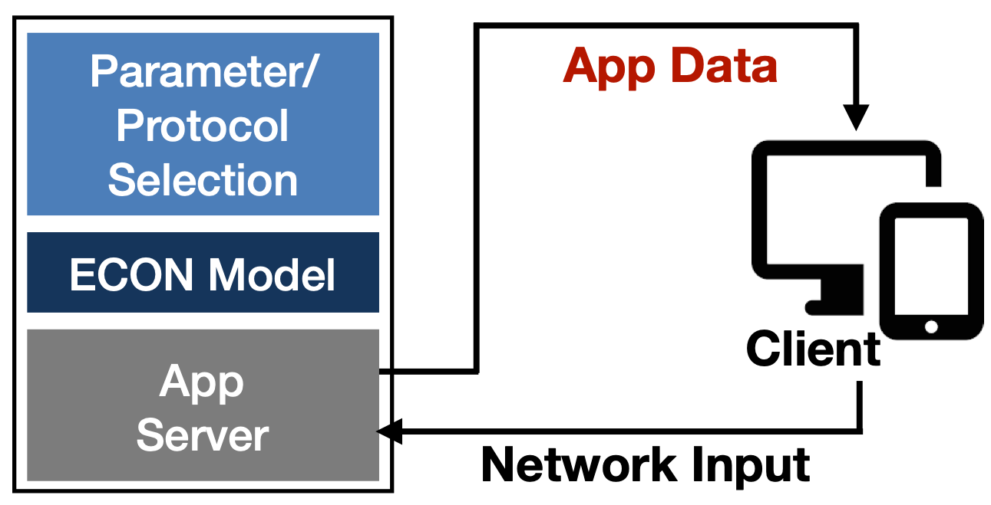

ECON Summary
ECON Framework
Application performance depends on
    Complex cross-layer interactions
    Dynamic network conditions
We present a new modeling approach: ECON
    Leverages empirical function p(cwnd)
    Significantly improves TCP modeling accuracy
    Extended to application level model
  Reducing Web PLT
  Maximizing video quality
ECON Source Code
Notes:
To conclude, application performance depends on the the complex cross-layer interactions, as well as the underlying dynamic network conditions.
We propose a new modeling approach ECON. Which augments analytical modeling by the empirical function p(cwnd). Experimental results show that ECON significantly improves TCP throughput modeling accuracy.
We also show that ECON can be extended to the application layer to choose the optimal application layer protocol, which improves Web and Video performance.
The ECON source code has been made public on Github, please scan the QR code on the right to see the repository.

