Slide 1



Enhancing Mobile Apps to Use Sensor Hubs without Programmer Effort
Haichen Shen, Aruna Balasubramanian, Anthony LaMarca, David Wetherall

Slide 2
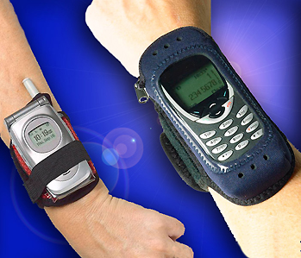
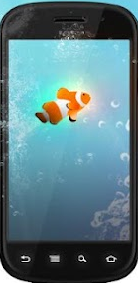

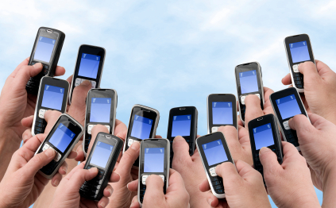




Continuous sensing apps
Healthcare apps:
Ambulation
Lifestyle monitoring:
BeWell, Acoustic
Participatory sensing:
MobiPerf
Step Counting
Fall Detection
Driver Monitor
Theft Detection
Notes:
Ambulation: a health monitoring application to monitor patients with mobility-affecting chronic diseases such as Parkinsons

Slide 3
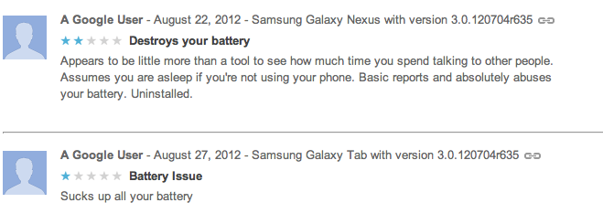
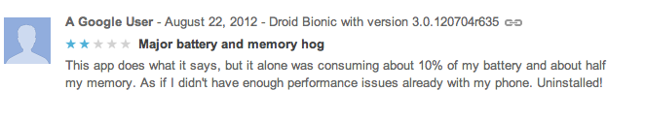
But it drains the battery
  Problem: CPU frequently wakes up to process sensor data
Notes:
It is neither the sensors nor the computation that make these applications battery drainers

Slide 4
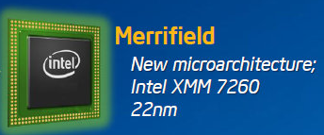
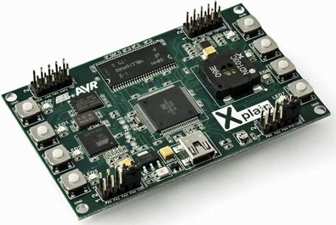


Sensor hub: low power processor
Intel Merrifield
TI’s Tiva
~1.5 mW at 2MHz
Apple M7
Notes:
Change the 1.5mW

Slide 5
Existing approaches
APIs
Provided by software company
Easy to program
Only support a set of pre-defined events
Require programmer effort
Hardware SDK
Provided by hardware manufacturer
Full control of sensor hub
Compatibility
Require programmer effort
Notes:
Android API vs Hardware SDK
In a seesaw
Requires programmer effort, cannot be used
Apps developed in one vendor’s environment will not work in another’s and vice versa

Slide 6


MobileHub: leverage sensor hub without programmer effort
Optimized app: Same semantics,
but more energy efficient
Analyze app and rewrite binary
MobileHub
System

Slide 7
MobileHub example
Steps:
App
Notification
0
1
Sensor
CPU
Display
Trigger
MobileHub
No change to app semantics
Steps:
0
1
Sensor
CPU
Display
[Idle]
  Challenge: How does MobileHub know when the application needs to be triggered?
Trigger
[Active]
CPU idle for longer
Notes:
If the app doesn’t have passive state, you cant help the app

Slide 8
System Overview
Step 0: Sensor traces
Original
app
Optimized
app
Step 1 Dynamic taint tracking: Track app notifications for a series of sensor inputs
Step 3b Application rewriting: Rewrite app to offload sensing to the sensor hub
MobileHub
System
Taint
log
Sensor parameter
Step 2 Learning: Learn how change in sensor values result in app notifications
Step 3a Sensor hub program: Implement the classifier in the sensor hub, corresponding to the app
Classifier
model
Notes:
Remove animation

Slide 9
System overview
Step 0: Sensor traces
Original
app
Optimized
app
Step 1 Dynamic taint tracking: Track app notifications for a series of sensor inputs
Step 3b Application rewriting: Rewrite app to offload sensing to the sensor hub
MobileHub
System
Taint
log
Sensor parameter
Step 2 Learning: Learn how change in sensor values result in app notifications
Step 3a Sensor hub program: Implement the classifier in the sensor hub, corresponding to the app
Classifier
model

Slide 10
Taint tracking
To track the flow of sensor data during the runtime and capture app notifications
Taint tag
void onSensorChange(sensorEvent){
X = sensorEvent.val;
Y = (X + 1) / 2;
if (Y > THRESHOLD) {
stepCounter++;
display(stepCounter);
}
}
Taint Source
Taint tag
Taint tag
Explicit Information Flow
Implicit Information Flow
Taint tag
Taint Sink
Notes:
- Definition of taint tracking?

Slide 11
Challenge: implicit flow
Most taint tracking platforms only track explicit flow
  Without implicit flow tracking, we could only track 20% of triggers for sensing apps
  Extend TaintDroid [Enck_OSDI2010] to track implicit flow

Slide 12
Implicit flow tracking example
void onSensorChange(sensorEvent){
X = sensorEvent.val;
Y = (X + 1) / 2;
tag = getTaintTag(Y);
if (Y > THRESHOLD) {
stepCounter++;
Taint(stepCounter, tag);
display(stepCounter);
}
}
Taint tag
Taint tag
Taint Block
TAINT
CAPTURED
  Use static analysis to identify all taint blocks and instrument the app binary automatically.

Slide 13
System overview
Step 0: Sensor traces
Original
app
Optimized
app
Step 1 Dynamic taint tracking: Track app notifications for a series of sensor inputs
Step 3b Application rewriting: Rewrite app to offload sensing to the sensor hub
MobileHub
System
Taint
log
Sensor parameter
Step 2 Learning: Learn how change in sensor values result in app notifications
Step 3a Sensor hub program: Implement the classifier in the sensor hub, corresponding to the app
Classifier
model

Slide 14



Learning a buffer policy
Hard to use a classifier to model the app logic
Simply learn the statistical properties and distinguish between idle and active periods
Label
Idle
Active
Trigger
Time

Slide 15
Goal: find a proper buffer size
Precisely predict active and idle periods
Reduce the number of notification delays
Notification delay!
More to save
Buffer
Buffer
Trigger
Buffer
Time

Slide 16
Implementation
Implemented in Android
  Taint tracking
  Interface with sensor hub
  App binary rewriting
Prototype
  Implemented classifier on sensor hub

Slide 17
End-to-end measurement
Notes:
5 minutes: 30 seconds stationary and manually moving it for 30 seconds in turn
22J vs 84J (almost 1/4)
Sensor hub power consumpt: 0.55J, 2.5%

Slide 18
Trace-driven evaluation
Trace collection from 21 participants
  10 traces for sleeping, driving, and daily life
  5 traces for other activities
Downloaded 20 apps from Google Play
Notes:
Trace contains a series of sensor input

Slide 19
Name | Google Play Store ID | Task | Sensor
nWalk | pl.rork.nWalk | Step counting | Accelerometer
pedometer | bagi.levente.pedometer | Step counting | Accelerometer
stepcounter | Stepcounter.Step | Step counting | Accelerometer
appsone | net.appsone.android.pedometer | Step counting | Accelerometer
virtic | jp.virtic.apps.WidgetManpok | Step counting | Accelerometer
walking | cha.health.walking | Step counting | Accelerometer
lodecode | com.lodecode.metaldetector | Metal detector | Magnetometer
imkurt | com.imkurt.metaldetector | Metal detector | Magnetometer
tdt | com.tdt.magneticfielddetector | Metal detector | Magnetometer
multunus | com.multunus.falldetector | Fall detector | Accelerometer
iter | com.iter.falldetector | Fall detector | Accelerometer
t3lab | it.t3lab.fallDetector | Fall detector | Accelerometer
fall | com.fall | Fall detector | Accelerometer
jietusoft | com.jietusoft.earthquake | Earthquake detector | Accelerometer
vibration | ycl.vibrationsensor | Earthquake detector | Orientation
posvic | cz.posvic.fitnessbar.sleeptrack | Sleep monitoring | Gyroscope
myway | myway.project.sleepmanagement | Sleep monitoring | Accelerometer
driving | jp.co.noito.Accelerometer | Driver monitoring | Accelerometer
motion | com.app.accelerometer | Motion detector | Accelerometer
thefthead | com.thefthead.appfinalsettings | Theft detector | Accelerometer

Slide 20
Methodology
Run each app on the phone receiving sensor values from a trace file
Trace file embeds the buffering policy
Power Accounting:
Measure the power consumption of phone
Deduct the standby power consumption

Slide 21
Evaluation
Does MobileHub reduce power consumption for sensing applications?
How much delay does MobileHub cause in the app notifications?

Slide 22
Energy improvement
Notes:
Average of 3 traces for each app
improve the power consumption by a median of 74%
Taking out the metal apps, mobilehub improves power consumption by 70% in average

Slide 23
Notification delay
Notification is delayed by at least 0.5s
App | Task | #Delay/#Notifications | Max delay (s)
nWalk | Step Counting | 1/3914 | 1.86
imkurt | Fall Detection | 2/142 | 0.98
posvic | Sleep Monitor | 1/36 | 0.64
thefthead | Anti-theft | 6/65 | 2.80
Notes:
Across all apps, 1.5% notifications are delayed
Max delay is less than 1 sec in 80% of cases
- Why 0.5 second ?

Slide 24
Conclusion
Design and implement MobileHub that rewrites application without programmer effort
Experiment with 20 sensing apps, and reduce power consumption by 74% in median
MobileHub delays 1.5% app notification across all apps on average

Slide 25
Thank you!

Slide 26
Back up

Slide 27
Sensor Hub Service
Sensor Hub
Sensor Hub Service
App
App
Comm. Manager
Sensor Listener
Sensor Listener
Sensor Distributor
Hub Binder
Hub Binder
Android Binder

Slide 28
Dynamic vs static buffer

