Slide 1
BBR Bufferbloat in DASH Video
Santiago Vargas*, Rebecca Drucker*, Aiswarya Renganathan, Aruna Balasubramanian, and Anshul Gandhi
* coauthors

Slide 2





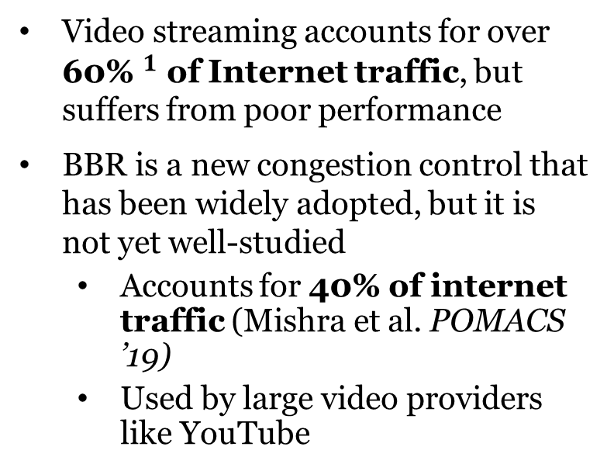
Why Video and BBR?
Video streaming accounts for over ${\text{60\%} }^{1}$ of Internet traffic, but suffers from poor performance
BBR is a new congestion control that has been widely adopted, but it is not yet well-studied
  Accounts for 40% of internet traffic (Mishra et al. POMACS ’19)
  Used by large video providers like YouTube
>60%
(2019)
1. https://www.sandvine.com/inthenews/netflix-falls-to-second-place-in-global-internet-traffic-share.
Notes:
How does *shiny, new* congestion control BBR work with *popular, growing* application, video?

Slide 3
Why Video and BBR?
Video streaming accounts for over ${\text{60\%} }^{1}$ of Internet traffic, but suffers from poor performance
BBR is a new congestion control that has been widely adopted, but it is not yet well-studied
  Accounts for 40% of internet traffic (Mishra et al. POMACS ’19)
  Used by large video providers like YouTube
>60%
(2019)
We investigate video QoE under BBR
1. https://www.sandvine.com/inthenews/netflix-falls-to-second-place-in-global-internet-traffic-share.
Notes:
How does *shiny, new* congestion control BBR work with *popular, growing* application, video?

Slide 4


Congestion Control and Bufferbloat
  Congestion control algorithms decide how fast to send packets
  Bufferbloat is excessive queuing delay in large network buffers
Bufferbloat!
No Congestion
Sender
Bottleneck Router
Receiver
Notes:
Hosts don’t know the buffer size

Slide 5
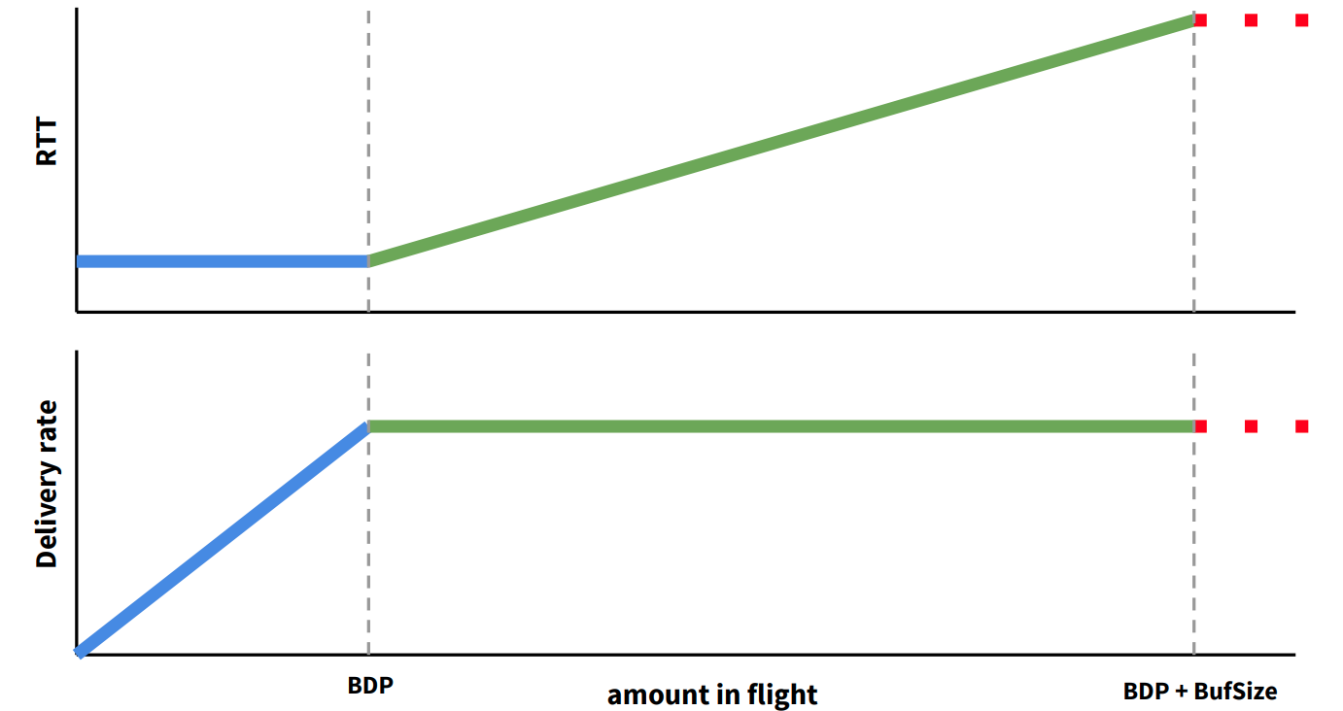
BBR: a new congestion control that combats bufferbloat
Buffer Build-up
BBR estimates the bandwidth-delay product (BDP) to set its sending rate
BDP is the theoretical network capacity
BBR Operating Point
$$BDP=bandwidth ∗propagation delay$$
max(delivery rate) min(RTT)
(Cardwell et al. 2017)
Notes:
RTT (round trip time)
Explain graph from left-to-right!

Slide 6





Measuring video QoE under BBR
Server
Congestion control (BBR, BBR2, or Cubic)
HTTP/1.1 or HTTP/2
OpenWRT router
Client
Latency (100ms):
TC NetEm
Bandwidth (25mbps) and buffer size: TC TBF
QoE Metrics: Segment Quality (0 to 10), Stall Rate
ABR Algorithms: DYNAMIC, BBA, BOLA, FESTIVE, rate-based
In total, we performed over 700 experiments
Notes:
Now that we know how bbr works, let’s see how it performs under video
We also performed some experiments in a WAN
Stall rate > 0 means rebuffering occurred
One important parameter is buffer size

Slide 7
Shallow vs. Deep Buffers
We want to know:
  Does bufferbloat affect BBR to the degree that video QoE is impacted?
  Does BBR outperform legacy congestion control (Cubic) in deep buffers?
Notes:
As we learned earlier, BBR should combat bufferbloat. Naturally we want to know if BBR can outperform Cubic in deep buffers.

Slide 8
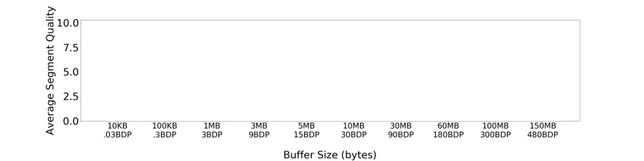


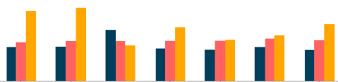
Poor video QoE under deep buffers
Low QoE under deep buffers across HTTP versions, RTTs, ABRs, and WAN settings
Notes:
We expect cubic to do poorly in deep buffers, but what’s going on with BBR??

Slide 9
Why does BBR experience poor video QoE under larger buffers?

Slide 10
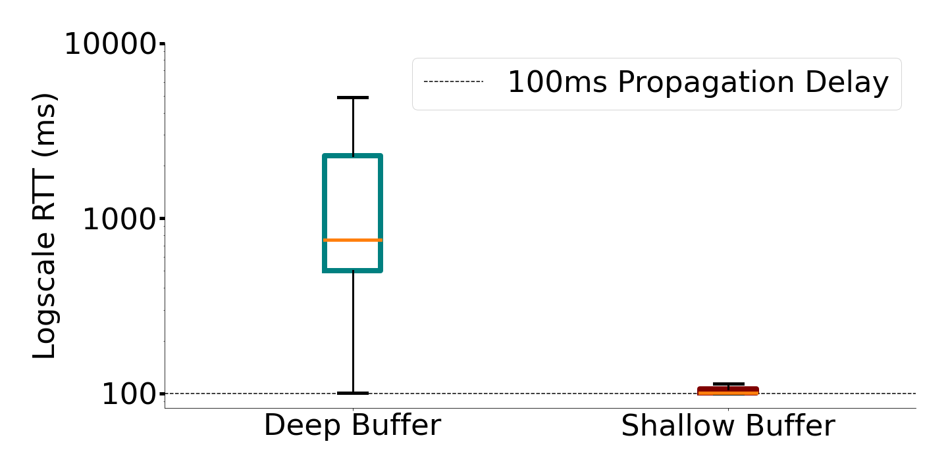
Low QoE due to high RTTs
  High RTTs slow down video downloads, hurting QoE
  Under deep buffers, >7x increase in RTTs
750ms
>7x increase
100ms
High RTTs under deep buffers reveal BBR Bufferbloat

Slide 11
Why is there bufferbloat under BBR?
BBR Bandwidth Over-estimation
BBR stuck in Startup Phase (Details in paper)

Slide 12
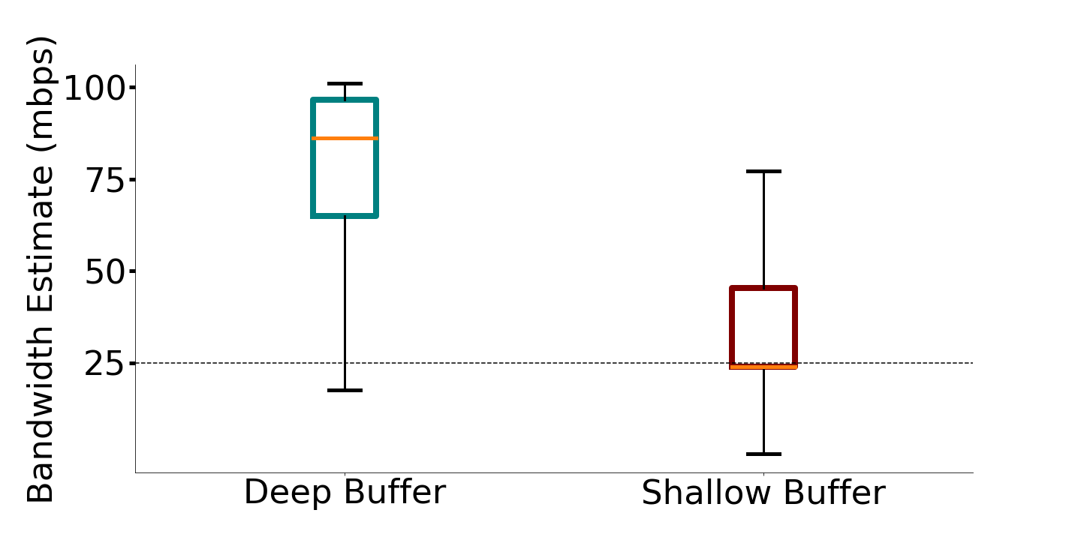
Bandwidth overestimation causes bufferbloat
  In deep buffers, BBR overestimates bandwidth >3x network capacity at the median
  Remember: BBR’s bandwidth estimation controls its sending rate
~80mbps
~25mbps
BBR bandwidth overestimation causes increased sending rate leading to Bufferbloat
Notes:
You might be wondering why we don’t see problems like this under shallow buffers

Slide 13
Network burstiness causes overestimation
BBR’s bandwidth estimate:
75 mbps
25 mbps
0 25 50 75
Delivery rate (mbps)
Time (RTTs)
Notes:
So we have now determined that BBR’s bandwidth overestimation is the cause of bufferbloat. But what is causing BBR to overestimate bandwidth? To understand this, we need to talk about bursty networks. A burst is a sudden, temporary increase in the delivery rate above the baseline bandwidth. This can occur for a number of reasons, but in our experiments, it happens because the router is configured to absorb bursts.
To illustrate the problem that bursts cause for BBR’s bandwidth estimation, I will show a synthetic example that is similar to what we saw in our experiments.

Slide 14
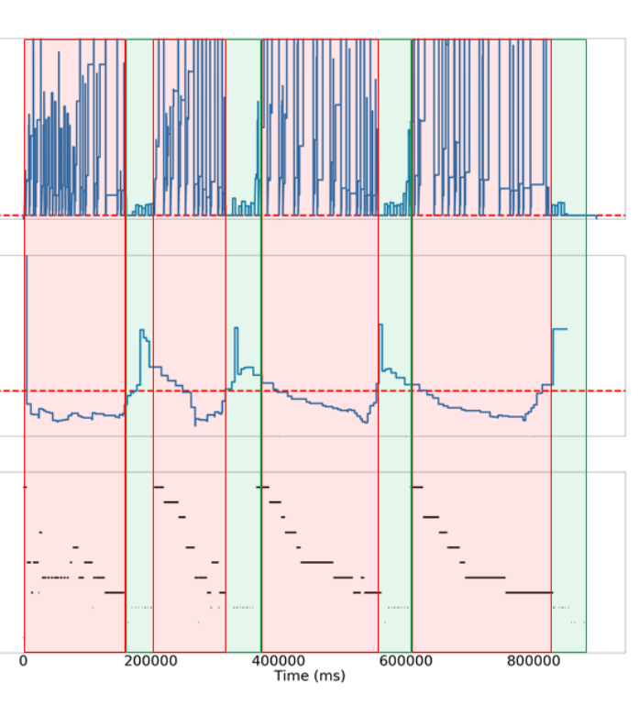




Interaction between BBR and ABR
Bandwidth overestimation causes BBR to send too quickly
Router queue
RTT
RTT
ABR est. Tput
Throughput estimate
Throughput estimate
Segment quality
Segment quality
Segment Quality
Router queue
RTT
Notes:
So how does chronic overestimation cause poor video qoe?
Keeping in mind that BBR is overestimating bw due to bursts… explain cycle
Red regions show bufferbloat
We can see this cycle in graphs of the video run

Slide 15

BBR-S: Bandwidth Estimation using Sampling
  Treat bandwidth measurements as a history of samples
  Discard excessively high samples (outliers) when estimating available bandwidth
BBR’s
bandwidth estimate:
75 mbps
25 mbps
0 25 50 75
Delivery rate (mbps)
Bandwidth Samples

Slide 16
BBR-S improves DASH QoE
  We repeat experiments under deep buffers
  BBR-S quality and stall rate similar to shallow buffers
  BBR-S accurately measures bandwidth and avoids bufferbloat

Slide 17
Conclusion
  Measure the performance of BBR and DASH video under diverse network settings
  Find poor video QoE under BBR with larger buffers and network burstiness
  Show that BBR suffers bufferbloat due to bandwidth overestimation
  Present BBR-S with modified bandwidth estimation to improve video QoE

