Slide 1

Need for Mobile Speed: A Historical Analysis of Mobile Web Performance
Javad Nejati, Meng Luo, Nick Nikiforakis, Aruna Balasubramanian
Stony Brook University
June 2020
Notes:
Good afternoon everyone. Welcome to my presentation.
Today, I am going to introduce our paper, Need for Mobile Speed: A Historical Analysis of Mobile Web Performance. This is a joint effort with my colleagues at Stony Brook University.

Slide 2

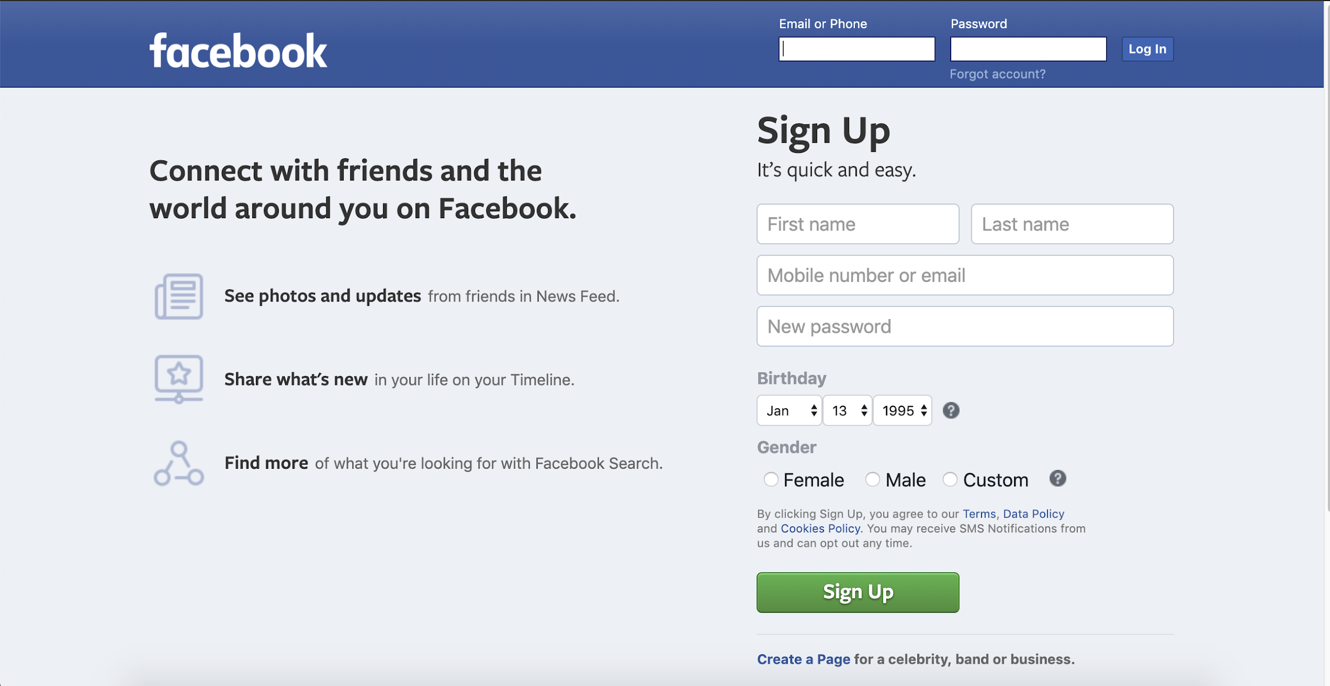
Web page loads are extremely critical
There are more than 4 Billion Internet Users.
*
A 1-Second DELAY in page load
7% Loss in conversions
11% Fewer page views
16% Decrease in customer satisfaction
Mobile Web performance is even more critical
Desktop
48%
Mobile
52%
  Mobile Web visits exceed Desktop ones**.
* strangeloop networks
** similarweb.com
Notes:
There are more than 4 Billion Internet users. and World Wide Web is their main portal to access information.
Based on a report, a 1 second delay in page load can cause 7% loss in conversion rate.
(The conversion rate is the percentage of users who visit the site and take a desired action, such as buying something on the site.)
and can lead to 11% fewer page views and 16% Decrease in customer satisfaction.
So Web page loads are extremely critical today.
Mobile Web performance is even more critical as 52 percent of devices used to browse Web sites are now mobile.

Slide 3
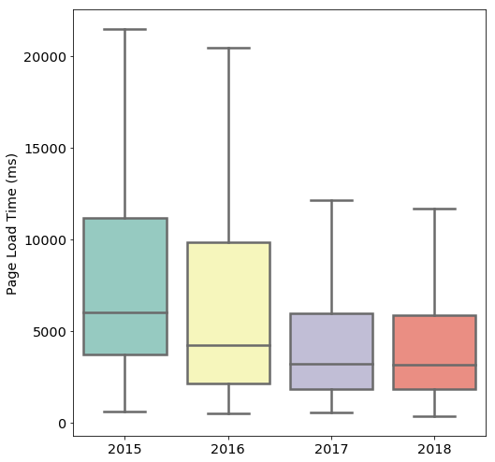
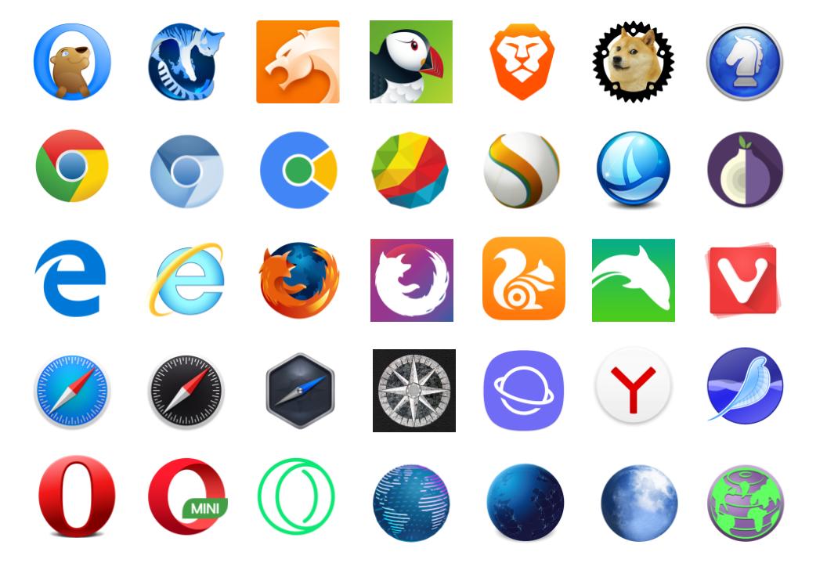
Mobile Web browsers are evolving
There exist hundreds of different mobile browsers on the Android Play Store
Web user experience has been improving
Notes:
Since mobile browsers are so critical, There have been a lot of efforts to improve them and as a result mobile browsers are continuously evolving. There exist hundreds of mobile browsers on Android play store only and with every new version, vendors promise a better performance
Anecdotally as well, there is a general agreement that mobile Web performance has improved over the years.
and in fact, we observe that for 3 sample browsers we have tested (Chrome, UCBrowser, Opera) Web user experience has been improving over the years.

Slide 4
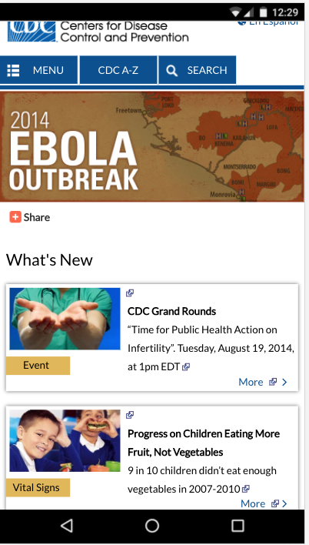



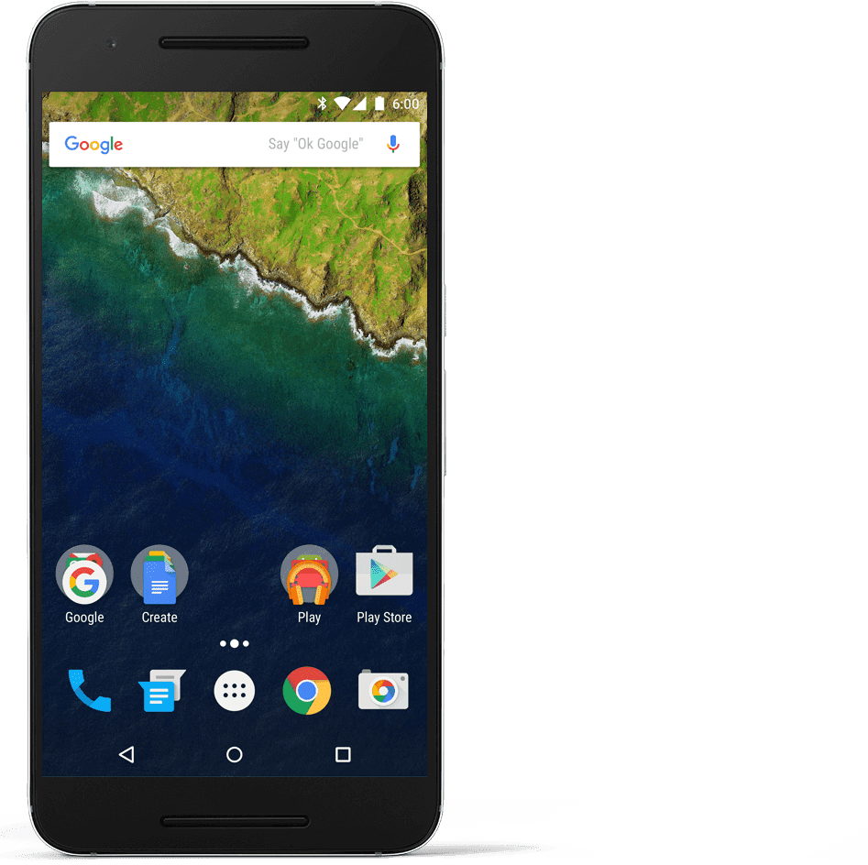
Goal: Study the evolution of mobile browser
user experience from 2015 to 2018
2015 user experience
2018 user experience
Download: 2Mbps
Upload:800Kbps
Delay: 300ms
Download: 11.1Mbps
Upload: 5Mbps
Delay: 50ms
Nexus 4
Nexus 6P
Notes:
Our goal is to study the evolution of mobile browser user experience from 2015 to 2018. We want to study how the user would have experienced the page load process in 2015, 2016, 2017, and 2018. In other words, we want to emulate the 2015 user experience when a user is browsing on Web pages from 2015, on a 2015 phone and operating system, using network conditions that were prevalent in 2015 and compare it to the user experiences in 2016, 2017, and 2018.

Slide 5
What factors contribute to this improvement in performance.
Better browsers
Improved networks
Newer hardware
Optimized web pages
These improvements are not universal
Only 7% of mobile connections across sub Saharan Africa in 2018 were 4G.
Phone budgets are different in different regions:
  Intex Amaze 4 (≈$60) and Gionee (≈$150) are two popular phones in India.
Notes:
The reason we want to study the historical performance of mobile browsers is because we want to understand the factors that has contributed to the improvement in mobile browser performance. There are several factors that can result in the improve in browser performance over the years.. Is it because of better browsers, improved network conditions, newer hardware or optimized Web pages.
It is important to find what factors play a more important role as these improvements are not universal.
Only 7% of mobile connections across sub Saharan Africa in 2018 were 4G. If network is a dominant factor in performance, then people in sub Saharan Africa are unlikely to see improved Web performance.
Also ,phone budgets are different across different regions:
For example, Intex Amaze 4 (≈$60) and Gionee (≈$150) are two popular phones in India.
While in US more expensive Samsung and Apple phones have the lead.
So if the phones/hardware is the key reason for the performance improvement then this improvement will most certainly not be universal.

Slide 6









This paper: Study historical performance of browsers
8 popular mobile browsers
Across 4 mobile devices
Loading 150 Web pages
Light (<1MB), medium (1-3MB), and heavy (>3MB)
From 2015 to 2018
250K total experiments
Approach: Emulate performance of Web browsing as experienced by an average user from 2015 to 2018
Notes:
To understand the important factors involved, we conduct a historical study using 8 popular mobile browsers (chrome, opera,...)
across 4 mobile devices.
We choose 150 Websites out of 2000 pages from Alexa’s top 1M sites to cover different page sizes. We randomly choose 50 pages for each bucket. light (<1MB), medium (1-3 MB), and heavy (>3MB). These pages were retrieved using Internet archive’s Wayback machine’s API to reflect the period of time these pages were being used from 2015 to 2018. We ran over 250 thousand experiments in total.
To study historical performance, we emulate performance of Web browsing as experienced by an average user from 2015 to 2018
THIS PAGE IS NOT FORMATTED PROPERLY

Slide 7
Quantifying page load performance
1- Page Load Time (PLT)
The time between when the page is requested and when the Load event is fired by the browser.
2- SpeedIndex
A visual metric that measures the average time for visible content to appear on the browsers’ viewport. SpeedIndex is measured over a video of the page load process.
3- Time To Interactive (TTI)
Measures how long it takes for a page to become interactive.
We show results based on PLT in this talk since the other metrics follow the same trend in our study.
Notes:
To quantify page load performance we use three most popular metrics: Page Load Time (PLT). PLT is the time between when the page is requested and when the onLoad event is fired by the browser. PLT is the most common metric used to measure page load performance.
Recently, two other metrics have been introduced to better quantify page performance from the user’s point of view. SpeedIndex is a visual metric that measures the average time for visible content to appear on the browsers viewport. SpeedIndex is measured over a video of the page load process.
Time To Interactive (TTI) measures how long it takes for a page to become interactive . Example interactions include clicking on a link or using the auto-complete feature of a search bar.

Slide 8


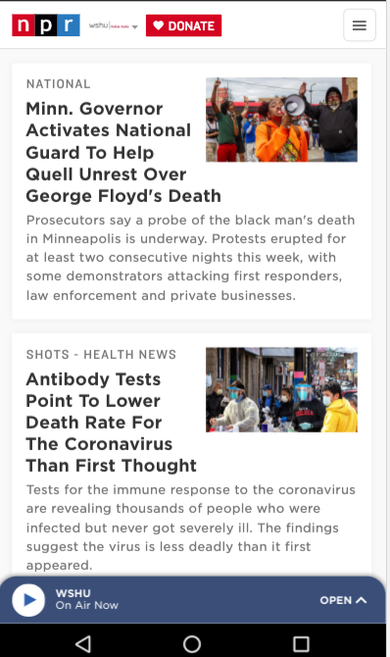
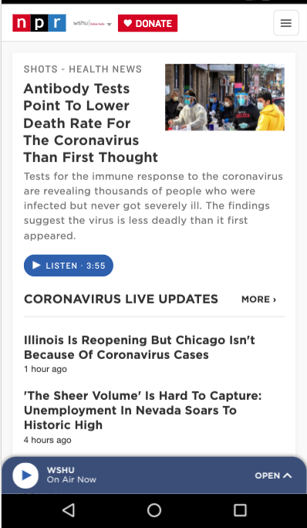


Challenges in performance measurement
Web Server
Content variations
Content variations
Network fluctuation
Network fluctuation
Lack of a universal browser management interface
Chrome has it’s own Remote Debugging Protocol.
Selenium supports only a few browsers.
npr.org now
npr.org 15 mins later
Notes:
However, there are challenges in measuring Web performance.
First, content variation. When we browse a Website, there is no guarantee that the content remains the same when we browse the same URL later. This has a major impact at what we are measuring.
The same argument is true for the access network. An interference in the wireless signal can lead to an increase in delay which consequently would increase the page load time.
And last but not the least, Most browsers provide a management interface so that an automation script can programmatically control the browser’s behavior. However these interfaces are not universal.
. We need a more generic approach.

Slide 9






Testbed Workflow
Replay
Inject
collector JS
Previously recorded pages
Replay www.npr.org
Request www.npr.org
Send metrics via Ajax
Web server
Set network parameters
Bypass splash screens
Install browser
Record screen
Experiment Automator
Video storage
Experiment Automator
9
Notes:
In order to address these issues. We have designed a controlled environment to mitigate content and network variations. Also, we take a more general approach in performance measurement that is supported by almost all browsers.
As the very first step , we record the contents of selected Web pages for each year using Internet archive’s API and store them locally.
we then spin up a replay server. the replay server loads the recorded archive file and act as a Web proxy to serve all incoming HTTP requests from mobile devices under test. This way we ensure that similar contents are being served during an experiment.
Then, xperiment automator applies desired network profiles to emulate network conditions for each year and also to limit the probable fluctuations.
The experiment automator is continuously managing the experiments by installing new instances of mobile browsers on devices, bypassing splash screens, and loading pages by launching the relevant activities through ADB .
For each page request, a script is injected into that Web page in order to collect performance metrics. This is script is based on JavaScript Performance interface that is widely available across different browsers and is not bound to only a limited number of browsers.
In parallel, a video of each page load is also being recorded and then pulled onto local storage for further analysis. We use this video to calculate the SpeedIndex metric.
The injected script sends the remaining metrics to our Web server via an Ajax call. This transmission happens after OnLoad event is fired on the page. These metric data are received on our Web server by a PHP program and stored locally as JSON files.

Slide 10



Testbed building blocks
Replay
Ajax data
Record/Replay (WprGo)
Inject
boomerang.js
Web Server
Script Injector
Install/Splash bypass
Android Debug Bridge (ADB)
App Launcher
Analysis
Traffic Control
Iptables
Video Recorder
Video Storage
Runner
Experiment Automator
Data/Analysis
A Controlled Environment
(Hindsight)
A General Framework
A Metric Collector
Notes:
Overall, our test bed provides:
1- A Controlled Environment to mitigate Content and Network variations.
We use Google’s WPR (from catapult project) as our record/replay server to serve similar contents for all of our experiments.
We also use linux Traffic Control (tc) utility to control network parameters.
2- The testbed also provide s a general framework capable of managing variety of browsers. We have customized Hindsight which is a browser-agnostic security framework as our experiment automator to install different mobile browsers, under different Android versions. Hindsight takes care of fresh installation (to guarantee a cold start), bypasses any splash screen and launches appropriate browser activities through ADB.
3- And finally this testbed is a metric collector, we inject Akamai Boomerang script in each page we serve.
Boomerang is a JavaScript library that measures the performance characteristics of real-world page loads and interactions..
THIS PAGE HAS NOT BEEN MODIFIED. IT HAS TO BE CONSISTENT WITH THE PREVIOUS SLIDE. YOU USE THE TERM EXPERIMEN AUTOMATOR, REPLAY ETC THOSE NEED TO COME HERE AS WELL.

Slide 11
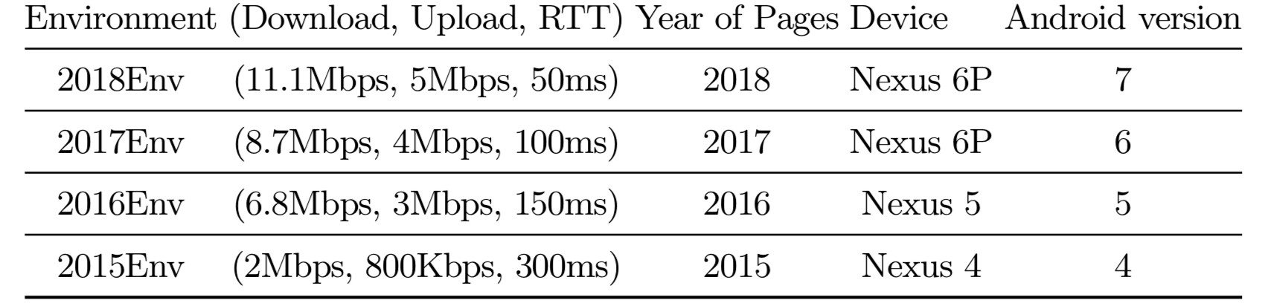
Methodology
Load Web pages to measure performance as seen in 2015, 2016, 2017, 2018
Source: Cisco Visual Networking Index
Notes:
To emulate network conditions for each year, we apply network profiles according to Cisco visual networking index to reflect an average user in the world.
For example, ‘2015Env’ indicates an environment in which the network is the average network available in year 2015, browser versions are those released in 2015, running on top of an Android device that was widely used in 2015 along with Web pages from mid-2015 (as captured by the Internet archive).
Similarly for 2016, 2017, and 2018.

Slide 12
Key findings
Q: What factors are causing the improvements in mobile Web user experience?
Optimized pages?
Web pages are becoming more complex
Optimized pages?
The network impact has saturated
Improved networks?
Improved networks?
Browsers are becoming more bloated and less performant
Better Browsers?
Better Browsers?
The increased performance is due to the more powerful underlying hardware and operating system.
Implication: Users who do no have access to newer phones will disproportionately be affected by bloated browsers.
Notes:
Web page performances are improving but Let’s get back to our original question. Which factors are causing this improvement?
Is it because of optimized pages? No, We find that Web pages are becoming more complex .This is also aligned with previous studies. And we are not going into details for this.
Is it because of better access networks? We find that network impact has saturated.
Is it because of better browsers? We find that browsers are becoming more bloated and less performant.
We find that this increased performance is due to the more powerful underlying hardware and OS.
In fact, the improved hardware masks the slowdown of newer browser versions and complex Web pages.
This has a significant implication for many regions across the globe that do not have access to newer phones.

Slide 13
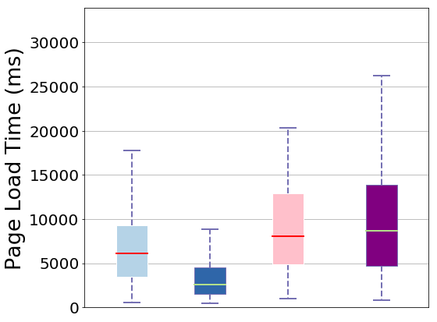
Finding 1: Older browsers perform better than newer ones (1/2)
2018 Device: running 2018 browsers
2015 Device: running 2015 browsers
2015 Device: running 2018 browsers
2018 Device: running 2015 browsers
Chrome
Notes:
So let’s get into details.
We find that 2015 browsers outperformed 2018 browsers, when running on the 2018 mobile device.
This is the page load time distribution for 2018 chrome browsers running on 2018 device.
and this is a 2015 device running 2015 Chrome browser. We observe that older chrome and older device perform better than newer environments when all other factors are kept constant.
Similarly, the 2018 browser is slower than the 2015 browser, when both are running on top of a 2015 mobile device.
Since all other factors were kept constant, this demonstrates that newer versions of browsers are slower than their older counterparts.
Newer browser are bloated usually to add more features but it comes at the expense of the performance.
THE 1 OF 2NEEDS TO BE ALIGNED WELL AND BE PART OF THE HEADING

Slide 14
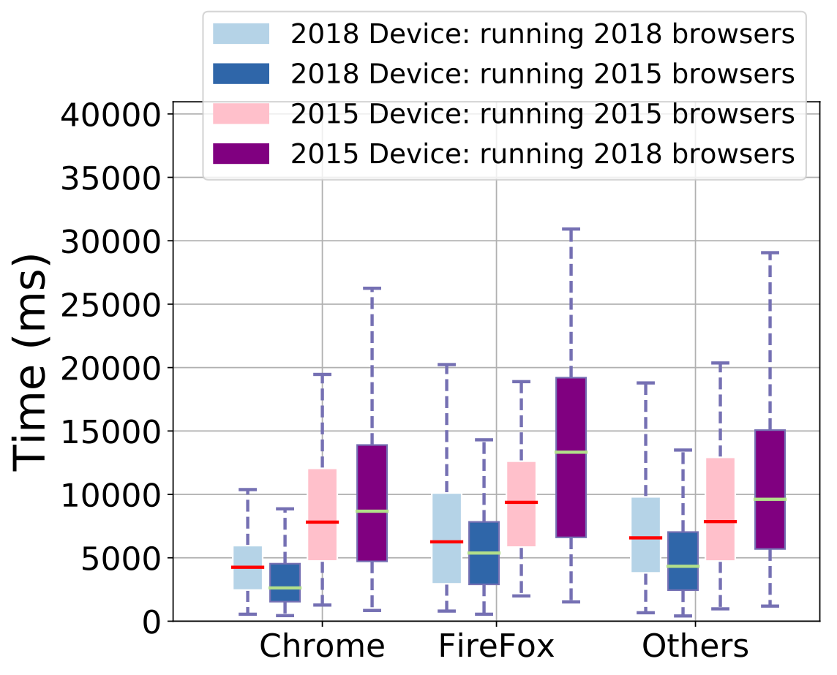
Finding 1: Older browsers perform better than newer ones (2/2)
Performance consequences of feature creep
14
Notes:
Similar trend is observed for FireFox and the remaining 6 browsers. Others in this plot is a representative of the median value for the 6 remaining browsers we have used in our measurements.
SAME FOR HERE, 2 OF 2 SHOULD BE PART OF THE HEADING

Slide 15
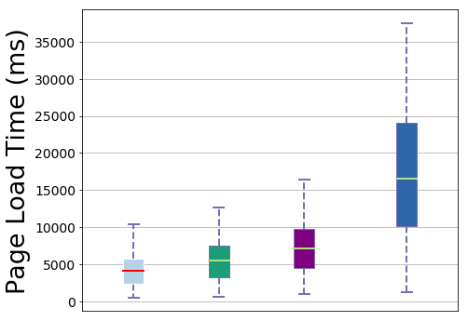
Finding 2: Saturation of network impact (1/2)
2018 network on 2018 device
2017 network on 2018 device
2016 network on 2018 device
2015 network on 2018 device
Chrome
Notes:
In another finding, we find network impact has saturated. This graph shows the network impact result for Chrome browser.
Here, we applied different network conditions to a recent browser and device.
We again keep all other factors constant and load 2018 Web pages on 2018 device and browsers.
click
This is 2018 network on 2018 device, followed by 2017, 2016, and 2015 networks.
The performance jump between the 2015 and 2016 network is the highest, With further improvement in network conditions from 2016 to 2018, there is only a modest improvement in PLT.
SAME HERE FOR 1 OF 2

Slide 16
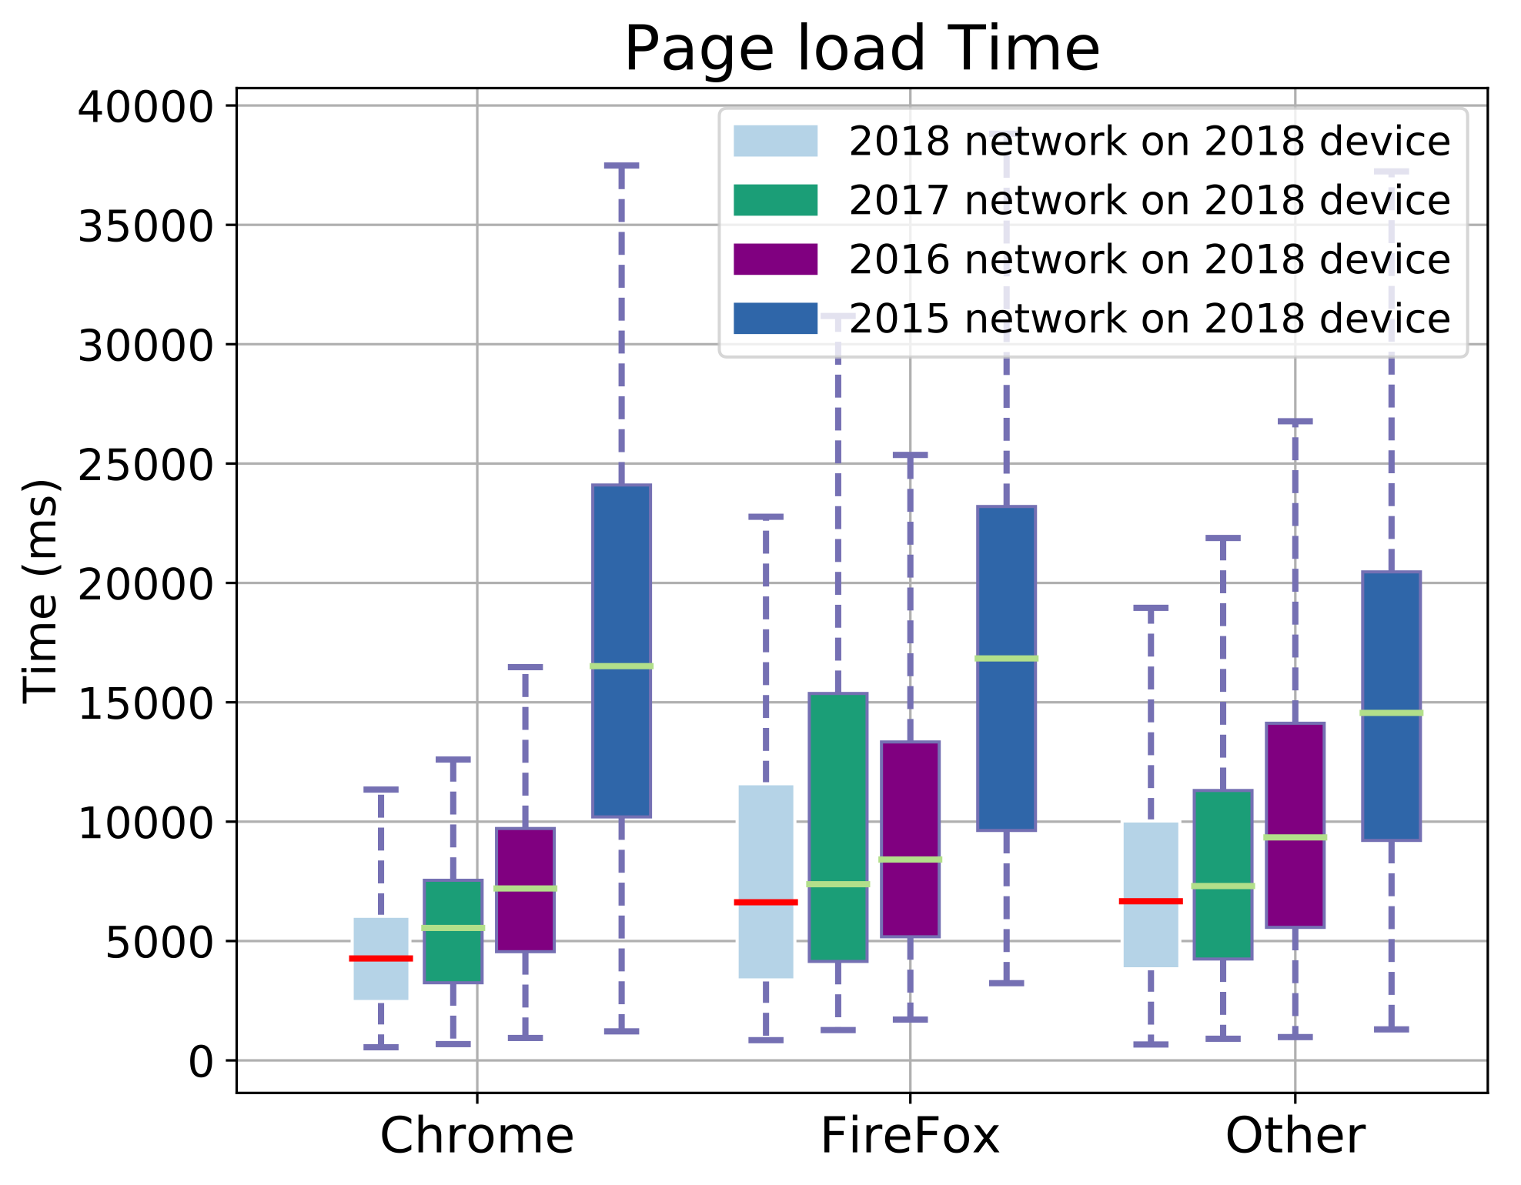
Finding 2: Saturation of network impact (2/2)
16
Notes:
Similar trend is observed for FireFox and the remaining 6 browser shown as other.
As you can see, the performance jump between the 2015 and 2016 network is the highest, and With further improvement in network conditions from 2016 to 2018, there is only a modest improvement in PLT.
YOU HAVE TO SAY MORE HERE. ALSO 2 OF 2 NOT ALIGNED WELL

Slide 17
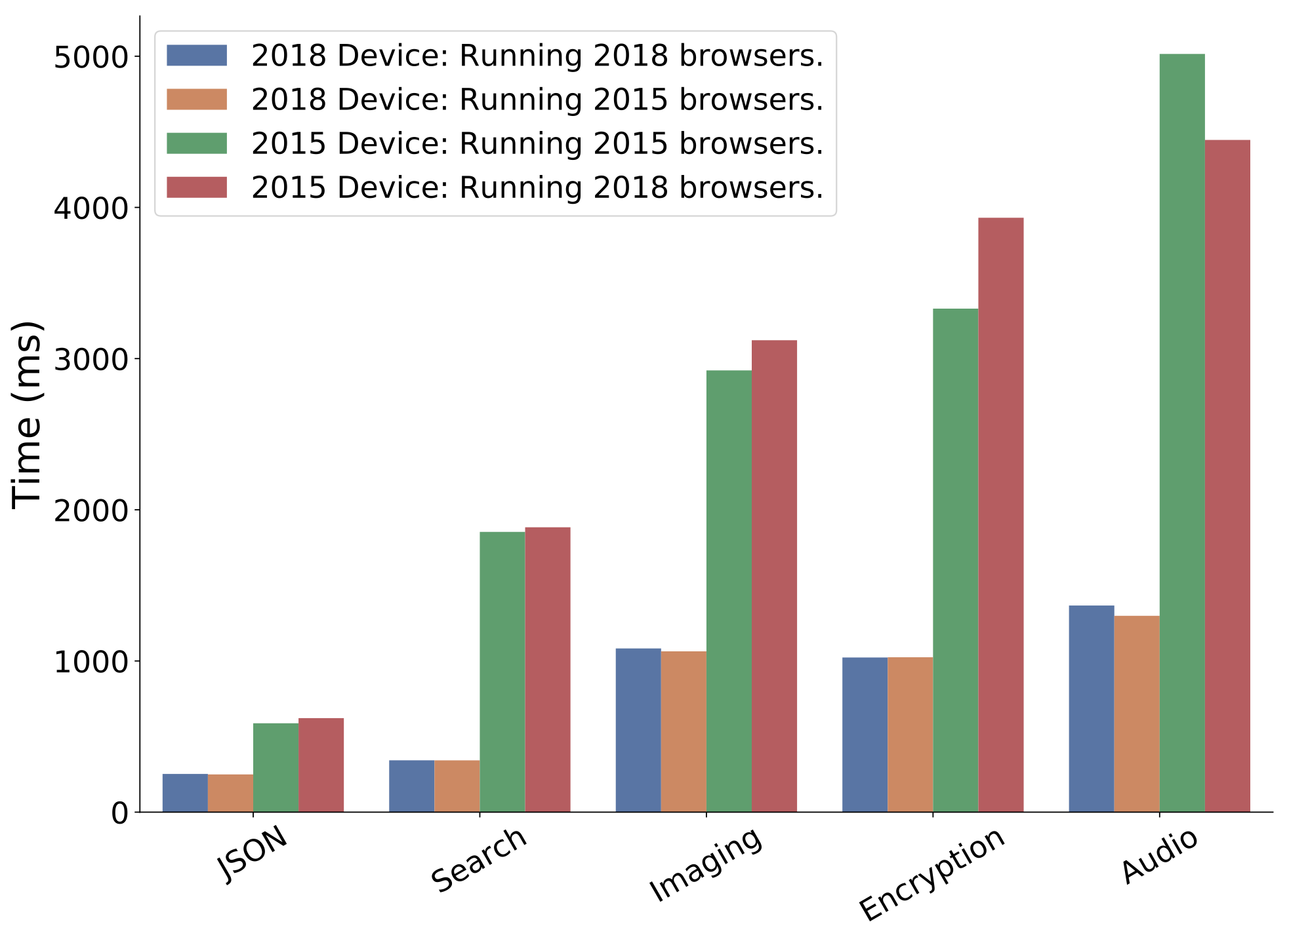
Finding 3: The increased performance is due to the more powerful underlying hardware and operating system
Kraken benchmark
Older browsers run better than
newer browsers on newer devices.
Notes:
We find that the increased performance is due to the more powerful underlying hardware and operating system.
To confirm this finding, we use a JavaScript-based performance benchmark from Mozilla (Kraken) on 2015 and 2018 Environments The results show that older browsers run better than newer browsers on new devices for the benchmarks.
Kraken focuses on realistic workloads and includes 14 benchmarks in 5 different categories:JSON, Search, Imaging, Encryption, and Audio. This Figure shows that the device is the main factor for its performance while the browser version has a small effect which usually is in favor of the older browser versions.
THE TITLE IS NOT ALIGNED. FINDING3 IS IN A DIFFERENT FONT THAN THE REST. THIS KRACKEN EXAMPLE IS NOT GOOD, PERHAPS FIGURE 11 IS BETTER. ALSO SOMEWHERE YOU SHOULD SAY PAGES ARE COMPLEX BUT YOU ARE NOT GOING TO SHOW THE RESULTS.

Slide 18
Finding 3: The increased performance is due to the more powerful underlying hardware and operating system
Notes:
We find that the increased performance is due to the more powerful underlying hardware and operating system.
This plot depicts the computation time for the same experiment for different pages across different devices. Computation time is total time of compute activities on the critical path. Critical path is the longest path on the page dependency graph composed of compute and network activities. We employ WProfX to calculate the computation time.
Here, We use the term “contemporary” to refer to using the version of pages that correspond to the underlying environment, i.e., 2016 pages were “contemporary” to the 2016 browsing environment. There, we again observe that the mobile devices spends less and less time on computation, even though pages are becoming increasingly complex.
THE TITLE IS NOT ALIGNED. FINDING3 IS IN A DIFFERENT FONT THAN THE REST. THIS KRACKEN EXAMPLE IS NOT GOOD, PERHAPS FIGURE 11 IS BETTER. ALSO SOMEWHERE YOU SHOULD SAY PAGES ARE COMPLEX BUT YOU ARE NOT GOING TO SHOW THE RESULTS.

Slide 19
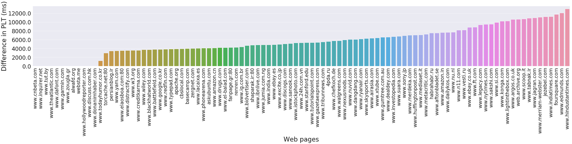
Browsers are not similar
There is little difference in median Web page load performance.
However, for 87% of the webpages, the difference in browser performance ranges from 2 seconds to 12.9 second
Notes:
On a side note, we observed little difference in median Web page load performance, across the 8 browsers that we tested.
However, when we plotted the difference in median PLT between the best performing and worst performing browsers for each website, we find that even though for 13% of the webpages, all browsers have similar median performance, for 87% of the webpages, the difference in browser performance ranges from 2 seconds to 12.9 second.
However, we could not find any correlation between this performance differences across browsers and Web page features.

Slide 20
Conclusion
The underlying hardware of newer mobile devices is the key driver of mobile Web improvements.
Older browsers run faster than their newer counterparts on the same hardware.
Network improvements provide diminishing returns in terms of page performance
We have shared the code at https://www.github.com/jnejati/tma2020
Notes:
To conclude this talk, we find that:
The underlying hardware of newer mobile
Network improvements provide diminishing returns in terms of page performance
The underlying hardware of newer mobile devices is the key driver
of mobile Web improvements.
devices is the key driver
of mobile Web improvements.
THE FORMATTING ON THIS PAGE IS OFF

Slide 21
Q&A
Notes:
Thank you everyone and now I will take questions.

Slide 22
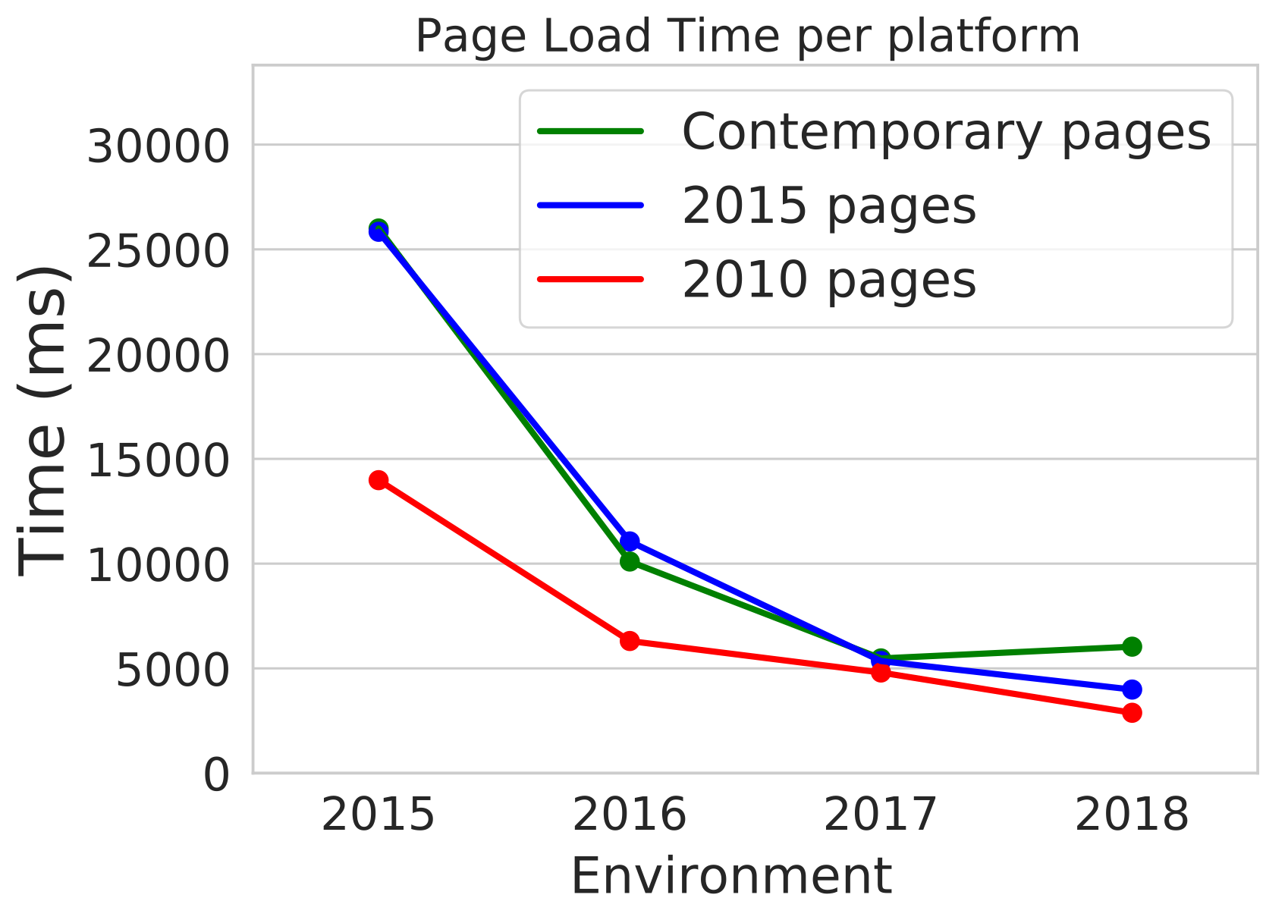
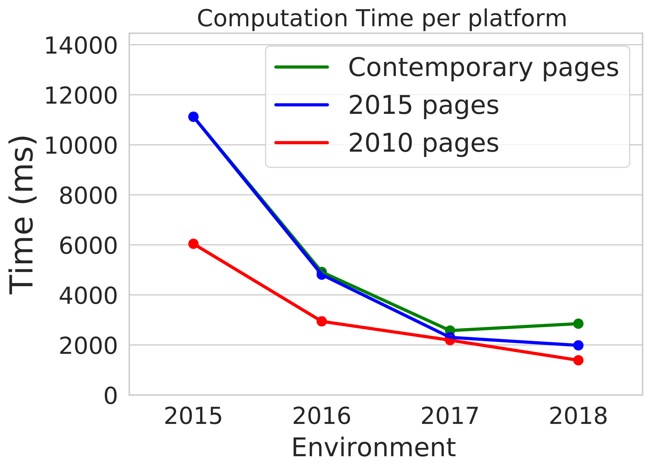
Finding 2: Page load time and computation time follow the same trend.
Computation time is total time of compute activities on the critical path.
Notes:
It is not network and browsers we check the device .

Slide 23
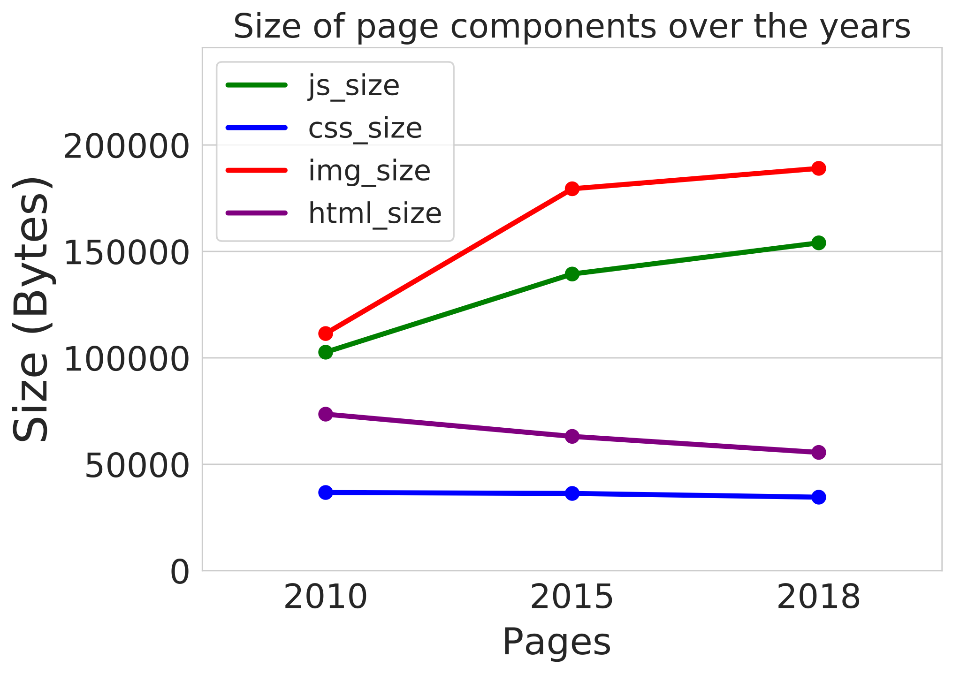
Finding 4: Pages are becoming increasingly complicated
Notes:
A 2010 version of a Web page loads faster compared to a 2015 version of the same page, under older network and device conditions. This is largely because pages are becoming more complex; the image size has nearly doubled in 2018 compared to 2010 (c).

