Slide 1
JawSense: Recognizing Unvoiced Sound using a Low-cost Ear-worn System
Prerna Khanna∗†, Tanmay Srivastava∗ §, Shijia Pan★, Shubham Jain†, VP Nguyen‡
† Stony Brook University, New York, USA
§ Indian Institute of Technology, Gandhinagar, India
★ University of California, Merced, USA
‡ University of Texas at Arlington, Arlington, USA
* co-primary authors
Notes:
Hello everyone. I am Prerna Khanna, a first year PhD student at Stony Brook University. Today I will present JawSense: Recognizing Unvoiced Sound using a Low-cost Ear-worn System.
This is a joint work with our collaborators from IIT Gandhinagar, UC, Merced, and UT Arlington.

Slide 2
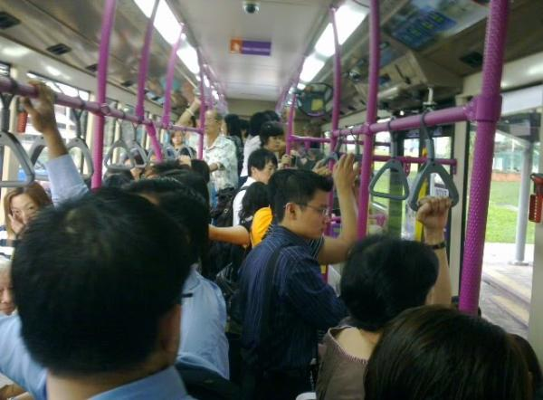
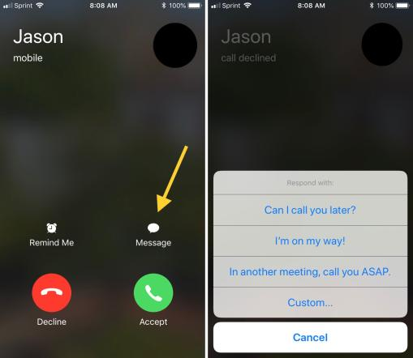
Motivation
Notes:
Let’s consider a scenario, you are travelling by public transport, both of your hands are occupied you and receive a call from a friend. Speaking in a public setting is not desirable and can also pose a privacy breach. Texting in the case with hands occupied is also difficult.
What if you could convey the message in an unvoiced manner, without anyone hearing it and still being able to communicate??

Slide 3
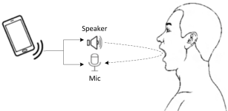
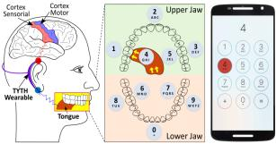
Need of new input modality
Silent Talk: INFOCOM 2017
TYTH: MobiSys 2018
Contactless Approaches
Camera; Wi-Fi; Ultrasonic Signals
Contact Approaches
Teeth typing; Localization
No on-body sensor
Handsfree operation; agnostic to environmental conditions
Privacy concerns; affected by ambient environment conditions
Not intuitive as language
Notes:
To recognize the unvoiced commands, various input modalities have been proposed by the previous works. This includes contactless approaches, like camera, wifi, and ultrasound based lip reading systems. Contact approaches like teeth typing are also present.
They have their own set of advantages and limitations. Advantages being they provide handsfree operation. But on the other side, some are affected by environmental noise, while some are not as intuitive as language based systems.

Slide 4
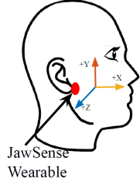
Our Proposed System - JawSense
Recognition
/i/
Low cost, retrofitted to commodity headphones
As intuitive as spoken language
More privacy preserving
Robust to environmental noise
Notes:
To bridge the gap, we develop JawSense a low cost earable that captures jaw movements to decode unvoiced sounds articualted by the user. Key takeaways of Jawsense are:
It is Low cost and can be retrofitted to commodity headphones.
it is as intuitive as spoken language.
Addresses privacy concerns raised by previous approaches and thus more privacy preserving.
It is Robust to environmental noise.

Slide 5
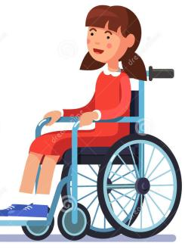
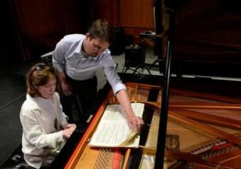
Range of Applications
Next
Neuro muscular disorders restrict typing and speaking.
Flipping pages requires additional support.
Voice commands for VR systems can be distracting.
Notes:
Recognizing unvoiced speech can open a wide range of applications.
This can be used by people with neuro-muscular disorders, who have problems using their fingers to type or articulate proper sounds.
Pianist needs to flip pages, which interrupts their hands, while voice commands would interfere with the music.
In both the cases, having a device which recognizes their unvoiced commands, can serve the purpose.
Another application area is the use of unvoiced commands for VR games and login system, which is privacy preserving and also less distracting to household members.

Slide 6
How are words produced?
look up
Phrase
Words
look
up
Phonemes
/l/
/u/
/k/
/ə/
/p/
Phonemes are smallest units of distinguishable sounds in any language.
Notes:
Phonemes are the smallest units of distinguishable sounds in any language. Phonemes are the building blocks of a sentence.
Lets consider a phrase “look up”, consisting of words: look and up. Look is made up from the phonemes: l+u+k. Word up is made from the phonemes: ə + p.
Phonemes are the core principal, which Jawsense is built on.

Slide 7
Challenges in realizing JawSense
#1: Identifying ideal sensor placement.
#2: Distinguishing between voiced and unvoiced phonemes.
#3: Eliminating motion and external acoustic noise.
Notes:
However, while realizing jawSense, we observed 3 challenges:
1. Is to identify the ideal sensor placement
2. Is to distinguish b/w voiced and unvoiced phonemes
3. Is to eliminate motion artifacts and acoustic noise.

Slide 8
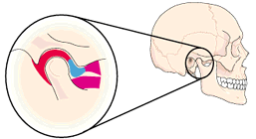
Challenge #1: Sensor Placement
Features of optimal locations:
Sensitive to jaw movements
Socially acceptable
Retrofit to commodity headphones
Temporomandibular
Joint (TMJ)
TMJ is the intersection of lower jaw and skull.
Notes:
We envision our device to be of wearable form factor, which is socially acceptable and can be retrofitted to commodity headphones.
Using the anatomical literature it was found that the Temporo-mandibular joint is sensitive to the jaw movements, since it acts like a sliding hinge connecting the skull and the lower jaw. It permits the jaw to move up and down, and in lateral direction.
Since, we want to capture the jaw movements and muscle activity of unvoiced phonemes, we place an accelerometer on the TMJ to capture the signal.

Slide 9
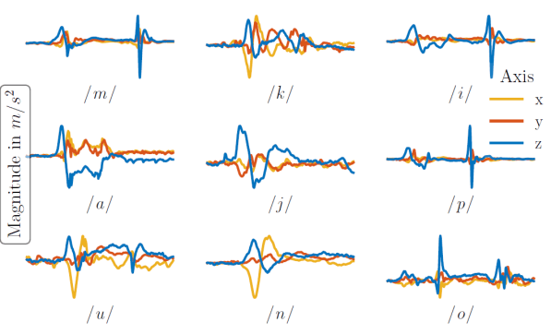
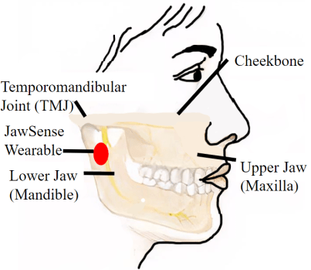
Solution #1: Sensor Placement
Single accelerometer sensor can capture micro motion caused by jaw movements.
Notes:
Now that we have identified the ideal position for sensor, can we use a single accelerometer sensor to capture human jaw movement during phoneme articulation?
Our experiments show time domain accelerometer signals for 9 phonemes, which demonstrates distinguishable characteristics.

Slide 10
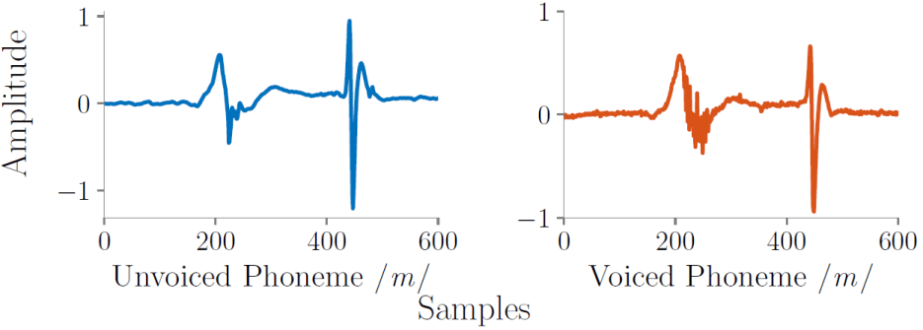
Challenge #2: Voiced or Unvoiced?
Jaw Closing
Jaw Opening
Jaw Closing
Jaw Opening
Skin Contraction
Skin Contraction
Voiced and Unvoiced phonemes look similar in time domain.
Notes:
Another challenge is to distinguish unvoiced signals from the voiced ones.
Time domain signal for the same phoneme in voiced and unvoiced manner looks similar for the jaw opening and jaw closing stage. Lets look closely at the skin contraction phase.

Slide 11
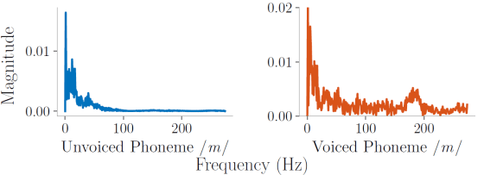
Solution #2: Voiced or Unvoiced?
Jaw Opening
Jaw Closing
Jaw Opening
Jaw Closing
Skin Contraction
Skin Contraction
Voiced phoneme introduces a high frequency component.
Notes:
But, if we look closely, voiced signals have a high frequency component in the skin contraction phase, as vibrations produced by the vocal cords during sound articulation travel up to prototype through cheek muscles.
This high frequency component can be used distinguish the two.

Slide 12
Challenge #3: Eliminating mechanical and motion noise
No Movement
Head
Movement/
Yawning
External
Acoustic
Noise
Power/ frequency (dB/Hz)
Frequency (Hz)
Time (s)
Motion artifacts and external sounds pollute the accelerometer signal.
Notes:
Let’s look at the 3rd challenge of eliminating noise.
Accelerometer along with jaw movements, can be affected by : body movements and mechanical waves like music from external sources. The spectrogram shows when a user is sitting idle, next figure shows while the user is performing different activities like head nodding, head rotation, yawning.
Last figure shows unvoiced phoneme articulation in presence of background music while wearing the JawSense prototype.
Now the challenge is to identify the unvoiced phoneme episodes in the presence of noise.

Slide 13
Solution #3: Eliminating mechanical and motion noise
No Movement
Head
Movement/
Yawning
External
Acoustic
Noise
Unvoiced
Phoneme
Power/ frequency (dB/Hz)
Frequency (Hz)
Time (s)
Noise episodes are removed by High Pass Filtering and Energy Based Thresholding.
Notes:
Body movements like nodding, yawning have far lower energy and frequency than other activities. Range of body movement is less than 1 Hz while jaw movements associated with unvoiced phonemes have a frequency profile in [5,100] Hz range. HPF can eliminate this noise.
For external noise removal we use energy based thresholding., we check in windows if the frequency range crosses a threshold. If it crosses, we call it an episode of external noise.
Using these assumptions these noises can be identified and removed by a suitable high pass filter.
Change time and power freq label

Slide 14
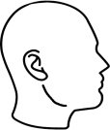
How JawSense works?
Accelerometer
Windowing
High Pass Filtering
Spectrum Area Selection
Accelerometer Data
Human Artefacts Removal
Unvoiced Phoneme Detection
Offset Removal
Frequency Analysis
Microcontroller
Threshold Analysis
Mean Average Filtering
Bluetooth Communication
Weiner Filtering
Pre-processing
External Acoustic Noise Removal
JawSense Hardware
Host Computer
Notes:
Hardware consists of ….
Preprocess….
To remove noise, we use high pass filter on the pre-processed signals as discussed before.
To separate unvoiced phoneme from voiced one, we rely on spectrum area selection, and look for high frequency components in the frequency spectrum. High frequency components can be used distinguish the voiced phoneme from the unvoiced ones.
Remove arrow

Slide 15
How JawSense works?
Accelerometer
Windowing
High Pass Filtering
Spectrum Area Selection
Accelerometer Data
Human Artefacts Removal
Unvoiced Phoneme Detection
Offset Removal
Frequency Analysis
Feature Extraction
Microcontroller
Threshold Analysis
SVM Classifier
Mean Average Filtering
Bluetooth Communication
Weiner Filtering
Detected Phoneme
Pre-processing
External Acoustic Noise Removal
Phoneme Classification
JawSense Hardware
Host Computer
Notes:
Next we extract time domain features and use SVM classifier to classify the 9 phonemes.

Slide 16
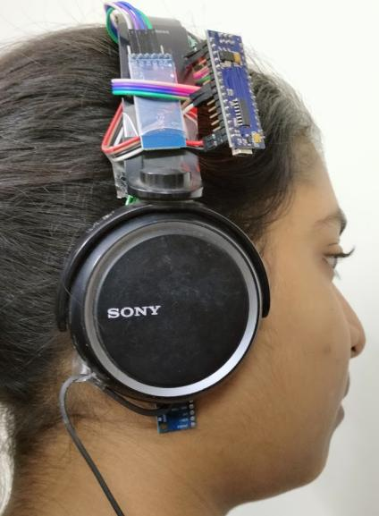
Prototype
Microcontroller
Design goals:
Small form factor
Bluetooth Module
Socially acceptable design
Accelerometer
Notes:
We built the JawSense prototype with two key design goals: (1) To have a small form-factor wearable that does not interfere with the jaw functioning, and (2) To have a socially acceptable design.
We used an off the shelf IMU, micro-controller and Bluetooth.
Our prototype collects the three axes accelerometer data at 550 Hz. The system communicates to a laptop via Bluetooth.

Slide 17
Experimental Setup
Collected data from 6 volunteers.
Participants were aged from 17-55 years, with 3 males and 3 females.
Each participant collected 20 samples for 9 most spoken phonemes.
Notes:
For evaluating our system, we conducted real world experiments with 6 volunteers, in different age groups.
Each participant collected 20 samples for each of the 9 phonemes.

Slide 18
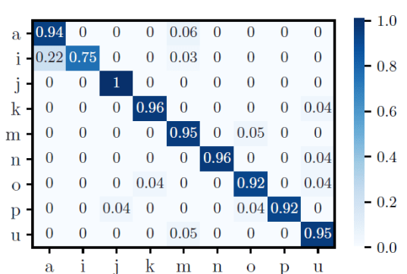
Evaluation: Phoneme classification
SVM classifier
Selected features:
Skewness
Area under the curve
Kurtosis
First 8 DFT coefficients
92% average accuracy
84% leave one user out accuracy
Notes:
We extracted time domain and frequency domain features to train a SVM.
confusion matrix for the classification of 9 phonemes and we achieve an accuracy of 92%.
Consistent bullets

Slide 19
Evaluation: Phoneme classification
# participants: 2
# trials: 20
Experiment setup with added noise:
Head nodding
Yawing
Articulating voiced phoneme
Background music
Notes:
We conducted experiments in noisy conditions to evaluate the sensitivity of JawSense. Some of the users also collected data with added noise.
The plot shows performance of Jawsense in these conditions. Under controlled conditions we achieve an accuracy of 96%. In episodes of external acoustic noise we have accuracy of 90% and 94% with human artifacts.
Add plot summary
Inc spacing b/w bullets
Move legend of the fig
Change 1st line

Slide 20
Conclusion
Proposed a low cost, intuitive and privacy preserving input modality.
Devised an algorithm to isolate unvoiced and voiced phonemes.
Evaluated system on 6 volunteers with of 92% average and 84% LOO accuracy.
Notes:
To summarize………

Slide 21
Future work
Phoneme aggregation to recognize words.
JawSense as speech verification and speech disorder detection system.
Making a system robust to large motion noises and test on larger sample size.

