Slide 1
Are Mobiles Ready for
BBR?
Santiago Vargas, Gautham Gunapati, Anshul Gandhi, Aruna Balasubramanian

Slide 2


BBR: New Kid on the Block
BBR is a dominant congestion on the Internet
Mobiles are popular
  60% of website traffic²
  Especially for next billion Internet users
BBR 40%¹
Question: How would BBR perform on mobiles devices?
¹ “The Great Internet TCP Congestion Control Census” (2019)
² https://www.oberlo.com/statistics/mobile-internet-traffic

Slide 3

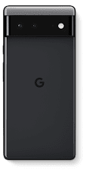
Making BBR Work on Android
BBR is undeployed on mobile devices
  Android phones are most popular¹
Use Pixel 4 and 6 devices
Enabling BBR and BBR2
  BBR: Include in Pixel 4/6 kernels
  BBR2: Backport into Pixel 6 kernels²
¹ https://www.statista.com/statistics/272698/global-market-share-held-by-mobile-operating-systems-since-2009/
² Available on Github

Slide 4
Mobile CPU Configurations
Wide range of Android devices: Low-end vs High-end
We want to know:
  Does BBR outperform legacy congestion control (Cubic) on mobile devices?
  Does BBR perform well under different mobile CPU configurations?
CPU Configuration | Frequency | Cores
Low-End | 576MHz | LITTLE
Mid-End | 1.2GHz | LITTLE
High-End | 2.8GHz | BIG
Default | Dynamic | Dynamic

Slide 5




Measuring BBR Performance on Mobiles
Pixel 4 and 6
OpenWRT Router
iPerf Server
Congestion control (BBR, BBR2, or Cubic)
CPU
Configuration
USB-to-Ethernet
(Wi-Fi and Cellular)
iPerf Performance: Goodput,
RTT, Retransmissions
Setup isolates the effect of the device/congestion control

Slide 6
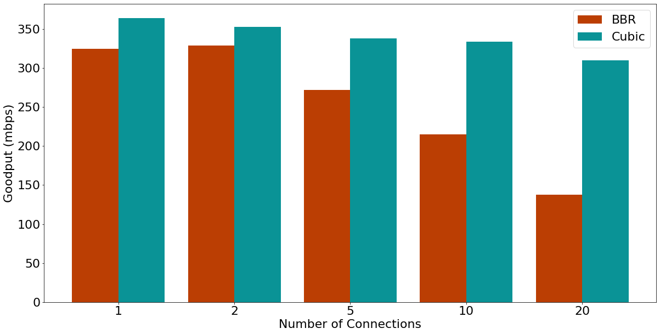
Cubic Performance under Low-End Config

Slide 7
Poor BBR Performance
Lower BBR goodput even with Wi-Fi, Default CPU, and BBR2 especially under more connections

Slide 8
Why does BBR experience poor goodput especially under
Low-End mobile CPU configurations?

Slide 9




Differences between BBR and Cubic
  Isolate the main differences between BBR and Cubic using a debugging version of BBR
  Differences:
  BBR code complexity
  BBR’s congestion model
  BBR uses pacing
Tests:
Removed BBR model computation
Fixed Cubic-like cwnd
Fixed very high pacing rates

Slide 10

How TCP Pacing Works
  TCP Pacing spaces out packets instead of sending all at once
Without Pacing: Packets sent as soon as possible
With Pacing: Wait for timer before sending
Pacing at a high rate is the same as not pacing at all

Slide 11
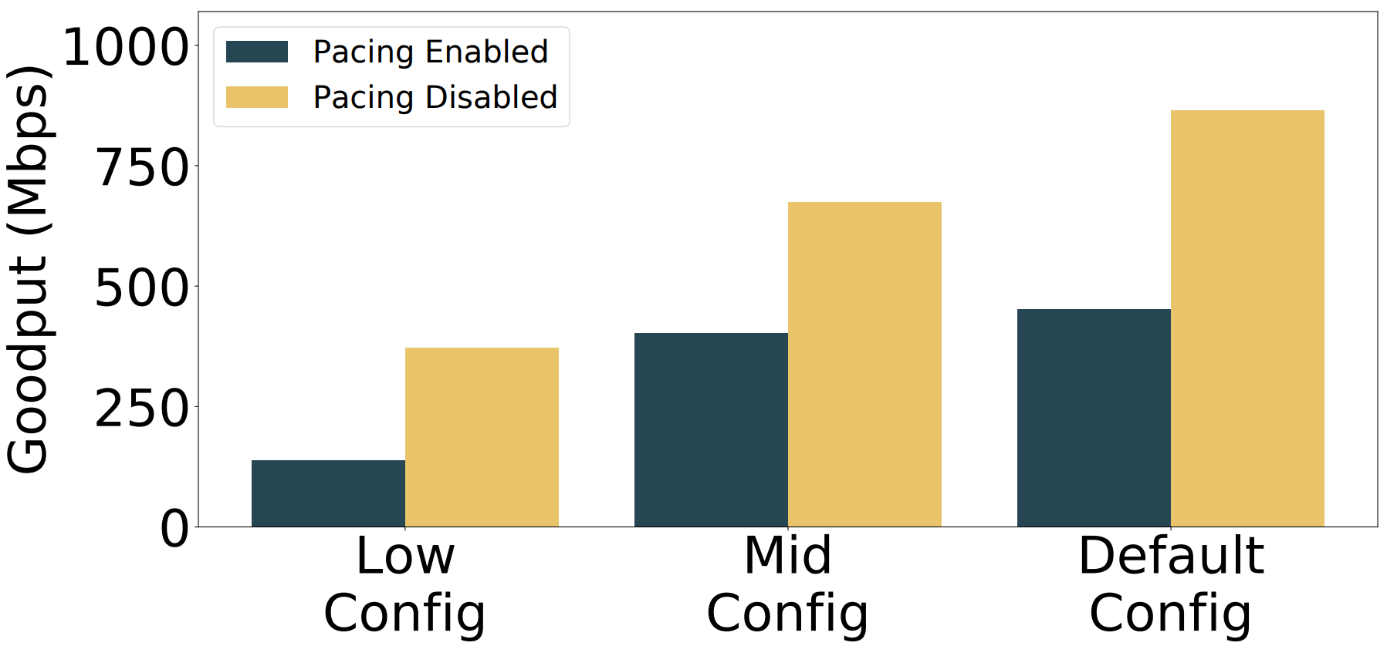
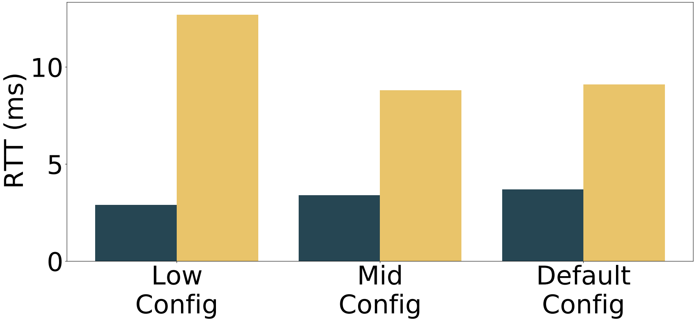
TCP Pacing Hurts Performance
Disabling pacing improves goodput but hurts RTT and retransmissions
Notes:
Pacing is bad even for Cubic

Slide 12
Approach: Change Pacing Frequency
  Goal: More data per pace that is paced less frequently
  Method: Increase TCP’s internal pacing timer by a factor of 3x (pacing stride)
Default Pacing:
3x Pacing Stride:

Slide 13
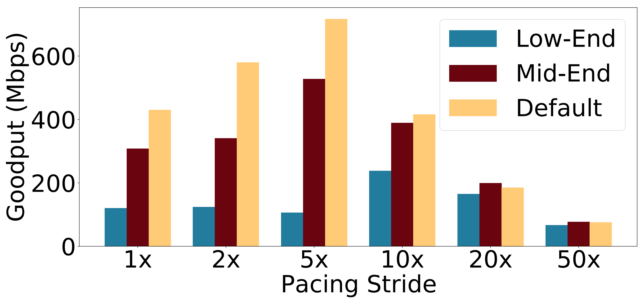
Pacing Stride Results

Slide 14
Pacing Stride Results
Pacing at greater strides improves performance on Low-End mobiles
Notes:
Near Cubic performance

Slide 15
Summary
Analyze performance if BBR is deployed on mobiles
BBR performance is worse than Cubic especially on Low-End phones and with many connections
TCP Pacing causes poor BBR performance
Introduce longer pacing strides to improve BBR on mobiles
Github: https://github.com/SBUNetSys/BBR2-on-Android

